Slide 1
Congruence and Similarity
Success Criteria
Starter
Developing students will be able to recognise similarity as one shape being an enlargement of the other. GRADE 5
What’s the same? How is this different?
4cm
42°
6cm
6cm
42°
Secure students will be able to identify equal side lengths and equal angles.
GRADE 6
9cm
4cm
6cm
42°
32°
8cm
4cm
Excelling students will be able to prove similarity and congruence.
GRADE 7/8

Slide 2
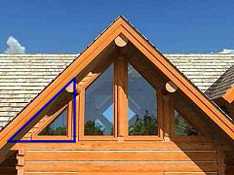
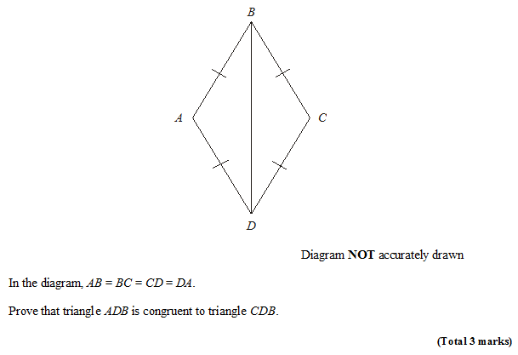
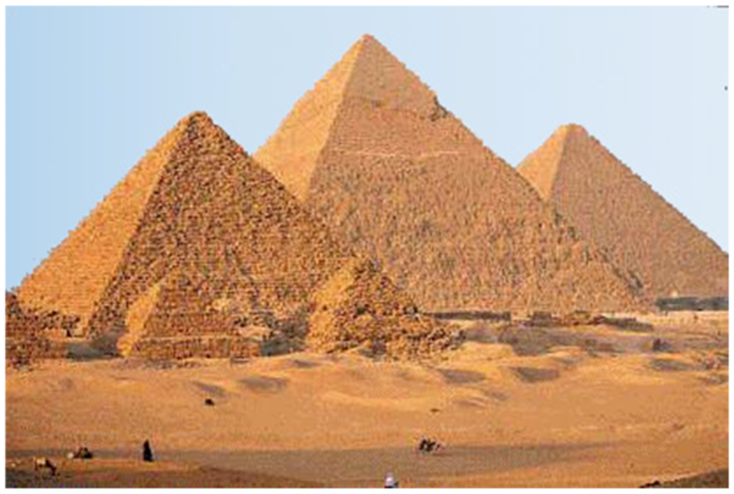
EXAM QUESTION
F.A.I.L

Slide 3
What is congruence?
These triangles are similar.
These triangles are congruent.
?
?
They are the same shape.
They are the same shape and size.
(Only rotation and flips allowed)
Congruent shapes have all sides and angles equal.
Similar shapes have all angles equal but one is an enlargement of the other

Slide 4
Modelled Example 1
Here are two triangles
× 2
× 2
5.3 cm
x
y
7.8 cm
× ?
2
4.7 cm
9.4 cm
Scale factor = ?
2
They are similar …
9·4 ÷ 4·7 = ?
…they have the same angles…
x = ?
5·3 × 2 = ?
10·6 cm
… there is an enlargement
between the triangles.
y = ?
7·8 ÷ 2 = ?
3·9 cm

Slide 5
Learning Phase 1
Exercise 1
6·48 m
y
3·5 m
4·2 m
(1)
Find the scale factor, the value of x and the value of y
4·3 m
x
(2)
4·5 m
10·8 m
y
3·5 m
x
9·84 m
(3)
x
8·4 cm
y
2·4 cm
4·4 cm
7·7 cm

Slide 6
Developing students will be able to recognise similarity as one shape being an enlargement of the other. GRADE 5 -
Answers 1
Scale factor = 1·2 x = 5·16 m y = 5·4 m
Scale factor = 2·4 x = 4·1 m y = 8·4 m
Scale factor = 1·75 x = 4·8 cm y = 4·2 cm

Slide 7
Modelled Example 2
Example 2
3·2 cm
3·5 cm
y
5·25 cm
4·2 cm
x
Find x and y
Scale factor =
5·25 ÷ 4·2 =
1·25
T¹
× 1·25
T²
x =
3·2 × 1·25 =
4·0 cm
y =
3·5 ÷ 1·25 =
2·8 cm

Slide 8
Learning Phase 2
Exercise 2
6·48 m
4·2 m
(1)
Find the scale factor, the value of x and the value of y
3·5 m
y
4·3 m
x
9·84 m
(2)
4·5 m
3·5 m
y
10·8 m
x
y
(3)
x
2·4 cm
7·7 cm
4·4 cm
8·4 cm

Slide 9
Developing students will be able to recognise similarity as one shape being an enlargement of the other. GRADE 5 =
Answers 2
Scale factor = 1·2 x = 5·16 m y = 5·4 m
Scale factor = 2·4 x = 4·1 m y = 8·4 m
Scale factor = 1·75 x = 4·8 cm y = 4·2 cm

Slide 10
Modelled Example 3
Example 3
y
x
3·6 cm
2·4 cm
4 cm
3 cm
Find x and y
Scale factor =
7 ÷ 4 =
1·75
T¹
× 1·75
T²
x =
2·4 × 1·75 =
4·2 cm
1·75 × 3·6 = y + 3·6
⇒
y = 1·75 × 3·6 – 3·6
⇒
y = 2·7 cm

Slide 11
Learning Phase 3
Exercise 3
1·5 cm
x
(1)
2·5 cm
Find the scale factor, the value of x and the value of y
5·5 cm
5
y
(2)
y
2·84 cm
3·28 cm
x
(3)
7·6 cm
1·9 cm
y
8
6
5
6
x

Slide 12
Secure students will be able to identify equal side lengths and equal angles.
GRADE 6
Answers 3
Scale factor = 1·6 x = 8.8 m y = 3 m
Scale factor = 1·25 x = 2·272 cm y = 0·82 cm
Scale factor = 1·2 x = 1·2 y = 1·6

Slide 13
EXAM QUESTION
F.A.I.L

Slide 14
What is congruence?
These triangles are similar.
These triangles are congruent.
?
?
They are the same shape.
They are the same shape and size.
(Only rotation and flips allowed)
Congruent shapes have all sides and angles equal.
Similar shapes have all angles equal but one is an enlargement of the other

Slide 15
Proving congruence
GCSE papers will often ask for you to prove that two triangles are congruent.
There’s 4 different ways in which we could show this:
For triangles to be congruent, three properties must be the same
!
a
?
SAS
Two sides and the included angle.
b
?
ASA
Two angles and a side.
c
?
SSS
Three sides.
d
?
RHS
Right-angle, hypotenuse and another side.

Slide 16
Proofs
Are these triangles congruent?
In pairs – Identify the proof associated with these triangles
6cm
6cm
4cm
3.5cm
4cm
3.5cm
3.5cm
4cm
78°
78°
Excelling students will be able to prove similarity and congruence.
4cm
3.5cm
47°
4cm
78°
47°
78°
4cm

Slide 17
Proving congruence
Why is it not sufficient to show two sides are the same and an angle are the same if the side is not included?
Try and draw a triangle with the same side lengths and indicated angle, but that is not congruent to this one.
Click to Reveal
In general, for “ASS”, there are always 2 possible triangles.

Slide 18
What type of proof
For triangle, identify if showing the indicating things are equal (to another triangle) are sufficient to prove congruence, and if so, what type of proof we have.
This angle is known from the other two.
⎦
SSS
SAS
⎦
SSS
SAS
⎦
SSS
SAS
⎦
SSS
SAS
ASA
RHS
ASA
RHS
ASA
RHS
ASA
RHS
⎦
SSS
SAS
⎦
SSS
SAS
⎦
SSS
SAS
⎦
SSS
SAS
ASA
RHS
ASA
RHS
ASA
RHS
ASA
RHS

Slide 19
Example Proof
Non Calculator
STEP 1: Choose your appropriate proof (SSS, SAS, etc.)
STEP 2: Justify each of three things.
STEP 3: Conclusion, stating the proof you used.
Solution:
$AD=CD$ as given
$AB=BC$ as given
$BD$ is common.
$∴ΔADB$ is congruent to $ΔCDB$ by SSS.
?
Bro Tip: Always start with 4 bullet points: three for the three letters in your proof, and one for your conclusion.

Slide 20
Check Your Understanding
$$A$$
$$B$$
$ABCD$ is a parallelogram. Prove that triangles $ABC$ and $ACD$ are congruent.
(If you finish quickly, try proving another way)
$$D$$
$$C$$
Using $SSS$:
Using $SAS$:
Using $ASA$:
?
$AD=BC$ as opposite sides of parallelogram are equal in length.
$∠ADC=∠ABC$ as opposite angles of parallelogram are equal.
$AB=DC$ as opposite sides of parallelogram are equal in length.
$∴$ Triangles $ABC$ and $ACD$ are congruent by SAS.
?
$AC$ is common.
$AD=BC$ as opposite sides of parallelogram are equal in length.
$AB=DC$ for same reason.
$∴$ Triangles $ABC$ and $ACD$ are congruent by SSS.
?
$∠ADC=∠ABC$ as opposite angles of parallelogram are equal.
$AB=DC$ as opposite sides of parallelogram are equal in length.
$∠DAC=∠ACB$ as alternate angles are equal.
$∴$ Triangles $ABC$ and $ACD$ are congruent by ASA.

Slide 21
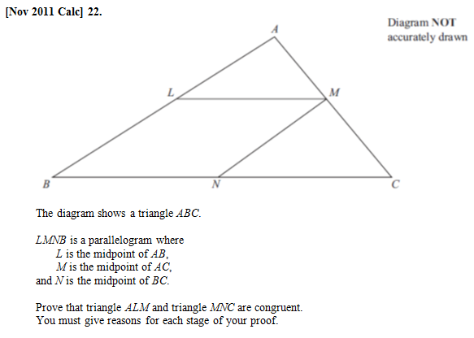
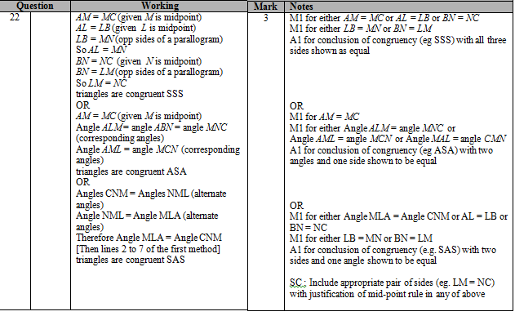
Exercises
(if multiple parts, only do (a) for now)
NOTE
Q1
?

Slide 22
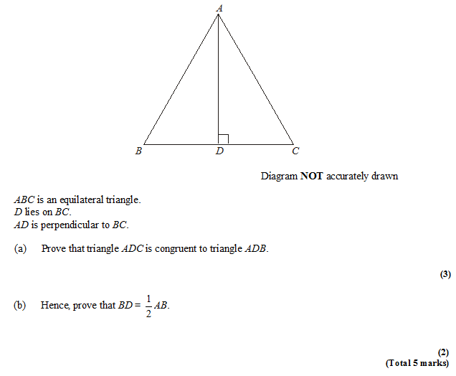
Exercises
Q2
?
AB = AC ($ABC$ is equilateral triangle)
AD is common.
ADC = ADB = 90$°$.
Therefore triangles congruent by RHS.
Since $ADC$ and $ADB$ are congruent triangles, $BD=DC$.
$BC=AB$ as $ABC$ is equilateral.
Therefore $BD=\frac{1}{2}BC=\frac{1}{2}AB$
?

Slide 23
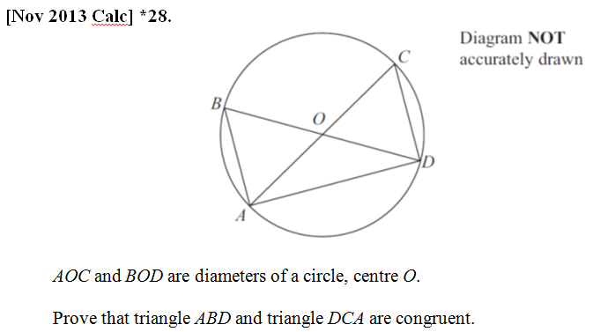
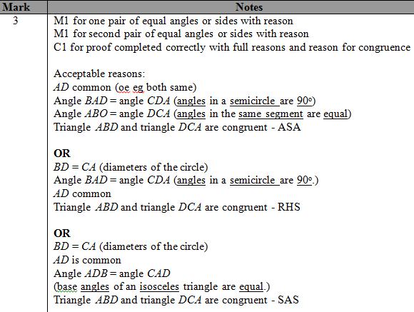
Congruent Triangles
Q3
?

Slide 24
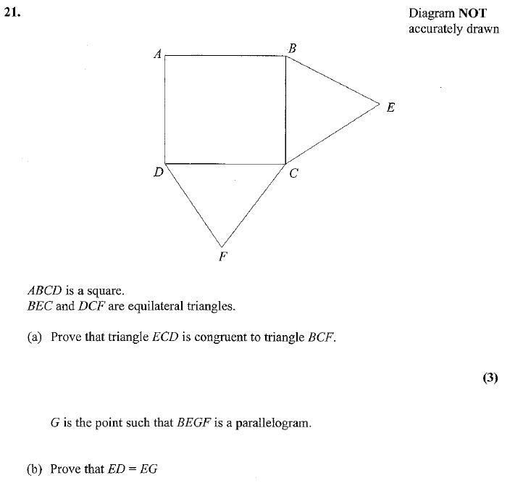
Exercises
Q4
BC = CE equal sides
CF = CD equal sides
BCF = DCE = 150º
BFC is congruent to ECD by SAS.
?
?
So BF=ED (congruent triangles)
BF = EG ( opp sides of parallelogram)
(2)

Slide 25
Check Your Understanding
What are the four types of congruent triangle proofs?
SSS, SAS, ASA (equivalent to AAS) and RHS.
What should be the structure of our proof?
Justification of each of the three letters, followed by conclusion in which we state which proof type we used.
What kinds of justifications can be used for sides and angles?
Circle Theorems, ‘common’ sides, alternate/corresponding angles, properties of parallelograms, sides/angles of regular polygon are equal.
?
?
?

Slide 26
Using completed proof to justify other sides/angles
In this proof, there was no easy way to justify that $AB=CD$.
However, once we’ve completed a congruent triangle proof, this provides a justification for other sides and angles being the same.
We might write as justification:
“As triangles ABD and DCA are congruent, $AB=CD$.”

Slide 27
Exercises
Q2
We earlier showed $ADC$ and $ADB$ are congruent, but couldn’t at that point use $BD=DC$ because we couldn’t justify it.
AB = AC ($ABC$ is equilateral triangle)
AD is common.
ADC = ADB = 90$°$.
Therefore triangles congruent by RHS.
Since $ADC$ and $ADB$ are congruent triangles, $BD=DC$.
$BC=AB$ as $ABC$ is equilateral.
Therefore $BD=\frac{1}{2}BC=\frac{1}{2}AB$
?

Slide 28
Exercises
Q4
BC = CE equal sides
CF = CD equal sides
BCF = DCE = 150º
BFC is congruent to ECD by SAS.
?
So BF=ED (congruent triangles)
BF = EG ( opp sides of parallelogram)
(2)

