Slide 1
resilience
Self-discipline
L.O. To be able to
Find the HCF and LCM of given numbers
Write a number as a product of its prime factors
Key Words
common, factor, multiple, highest, prime, product
Starter:

Slide 2
CONTENTS – Click to go to…
HCF AND LCM
LCM WORDED PROBLEMS
PRODUCT OF PRIME FACTORS
USING PRODUCT OF PRIMES TO FIND HCF AND LCM

Slide 3
HCF AND LCM

Slide 4
Notes:
Select pupils to come to the board and drag and drop the numbers down the right hand side in such a way that they are in a circle containing a multiple of that number (24, 36 or 40).
If the number divides into two of these numbers then it must be placed in the area where the two circles overlap.
If the number is a factor of 24, 36 and 40, it must be placed in the region where all three circles overlap.
Numbers which do not divide into 24, 36 or 40 must be placed around the outside of the circle.
Once the diagram is complete ask questions such as:
What are the common factors of 36 and 40?
What are the common factors of 24 and 30?
What is the highest common factor of 24 and 40?”
If we used different numbers would there always be a number in the section where the three circles overlap?
Establish that 1 would always be in the central overlapping section because 1 is a factor of every whole number.

Slide 5
Definition
The Highest Common Factor of two numbers is the largest number that is a common factor of both numbers. We call it the HCF.
List all factors of each number
List them in pairs so you won’t miss any out!
Circle all common factors
The highest circled number is the HCF

Slide 6
Example
Find the HCF of 24 and 30
Factors of 24:
Factors of 30:
So the HCF of 24 and 30 is:

Slide 7
Example
Find the HCF of 36 and 45
Factors of 36:
Factors of 45:
So the HCF of 36 and 45 is:

Slide 8
Task
Find the HCF of the following numbers...
8 and 12 e) 36 and 54
20 and 30 f) 18 and 24
12 and 18 g) 36 and 48
21 and 35 h) 56 and 24
Then challenge your partner to find the HCF of two numbers of your choice... how well do they do?

Slide 9
Find the HCF of the sets of numbers shown.
a
b
c
HCF 9 and 15
HCF 12 and 30
HCF 18 and 4
3
6
2
d
e
f
HCF 20 and 35
HCF 42 and 28
HCF 36 and 27
5
14
9
g
h
i
HCF 9, 54, 18
HCF 24, 56, 16
HCF 60, 36, 24
9
8
12

Slide 10
Definition
The Lowest Common Multiple of two numbers is the smallest number that is a common multiple of both numbers. We call it the LCM.
List the first few multiples of each number
Circle the common multiples
The lowest circled number is the LCM

Slide 11
Multiples of 6
12
60
6
18
54
66
102…
8
16
24
48
72
96
24
32
40
48
56
64
72
80
88
96
104 …
Multiples of 8
30
42
78
90
36
84
Notes:
Start by asking,
What is a multiple?
Let’s fill in the multiples of 8 on this straight strip.
Reveal the first number, 8, and allow pupils to call out each subsequent multiple before revealing it.
Now let’s fill in the multiples of 6.
Reveal the 6 and allow pupils to call out subsequent multiples as before.
What do we call the numbers where the two strips overlap?
They are called common multiples.
What is the lowest common multiple of 6 and 8?
The lowest common multiple is often called the LCM.

Slide 12
Example
Find the LCM of 8 and 10
Multiples of 8:
Multiples of 10:
So the LCM of 8 and 10 is:

Slide 13
Example
Find the LCM of 20 and 25
Multiples of 20:
Multiples of 25:
So the LCM of 20 and 25 is:

Slide 14
Find the LCM of the sets of numbers shown.
a
b
c
LCM 2 and 3
LCM 4 and 10
LCM 6 and 18
6
20
18
d
e
f
LCM 9 and 36
LCM 7 and 9
LCM 36 and 12
36
63
36
g
h
i
LCM 9, 54, 18
LCM 14, 28, 7
LCM 5, 6, 7
54
28
210

Slide 15
Task
Find the LCM of the following numbers...
4 and 10 e) 9 and 6
4 and 5 f) 7 and 5
5 and 9 g) 6 and 8
12 and 3 h) 6 and 7
Can you find the LCM of these harder numbers?
10 and 15
20 and 30
12 and 20

Slide 16
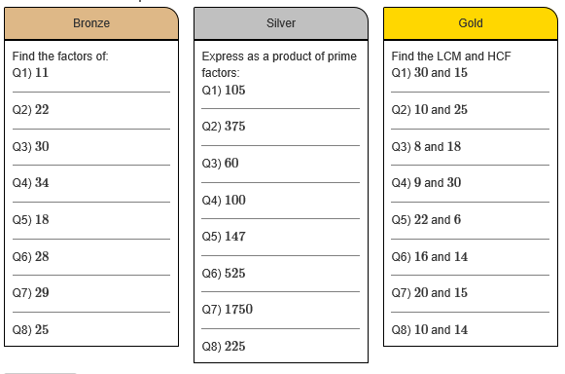

Slide 17
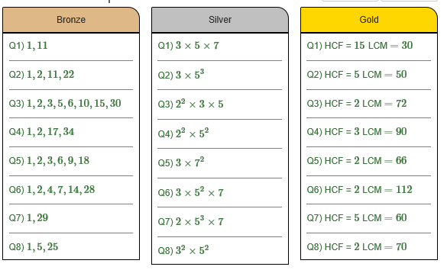

Slide 18
Discussion task questions
Why do we find the HIGHEST common factor, but then the LOWEST common multiple?
Can you think of examples of other maths topics where we could use the HCF or LCM to help us

Slide 19
USING THE LCM TO SOLVE WORDED PROBLEMS

Slide 20
LCM worded problems
Often a question will need you to find the LCM without explicitly using those words. Examples are…
Buying two or three different products that come in different sized packets, but wanting to buy the same amount of each product
A situation where two things leave a place at the same time and you need to find the next time when they are all there together (busses or trains leaving the station, racers being at the start line of a race track, etc)

Slide 21
LCM worded problems - Step by step
LIST the first few amounts for each of the different things in the question
Keep checking carefully to see if there are any common values in the lists!
Add more to the lists until you find a value that’s in common
Read and make sure that you answered the question correctly in the context given
Example
Rita is going to make some cheeseburgers for a party.
She buys some packets of cheese slices and some boxes of burgers.
There are 20 cheese slices in each packet.
There are 12 burgers in each box.
Rita buys exactly the same number of cheese slices and burgers.
How many packets of cheese slices and how many boxes of burgers does she buy?
Cheese slices: 20, 40, 60, 80, 100
Burgers: 12, 24, 36, 48, 60
So I need 3 packets of cheese slices, and 5 boxes of burgers

Slide 22
Exam question

Slide 23
Mark scheme

Slide 24
Some to try!
These are some past paper questions on this theme that are worth having a go at, to test your skills…

Slide 25
PRODUCT OF PRIME FACTORS

Slide 26
Key phrases
You could be asked to find the “product of prime factors” or the “prime factor decomposition” of a number. Both of these phrases mean the same thing.
Step by step
Draw a factor tree
Write out all the PRIME factors as a list, with a MULTIPLY symbol in between each number (a product of prime factors!)

Slide 27
180
Think of any pair of numbers that multiply to make 180
10
18

Slide 28
180
Think of factor pairs for both 10 and 18
10
18

Slide 29
180
10
18
2
5
6
3

Slide 30
180
When you get to a PRIME number, circle it and stop that branch
10
18
2
5
6
3
2
3

Slide 31
Example
Write 75 as a product of prime factors

Slide 32
Example
Write120 as a product of prime factors

Slide 33
Task
Write the following numbers as a product of their prime factors
20
32
72
195
26
130
330
60
45

Slide 34
SHORTCUT!!!
A quick way to find the product of prime factors can be done on your calculator…
Example
Write 36 as a product of prime factors
Type in 3 6 =
Press ^{shift} then press ᵒ’ ’’ (says FACT above the button)
Your screen will show the number as a product of its prime factors!

Slide 35
USING PRODUCT OF PRIMES TO FIND HCF AND LCM

Slide 36
Using the product of prime factors to find the HCF
Find the product of primes for each number
Circle pairs that are in BOTH lists
Multiply these paired numbers together
The result is the HCF
Using the product of prime factors to find the LCM
First find the HCF as above
Find all the “leftover” numbers (that didn’t pair up)
Times all the leftovers by the HCF
The result is the LCM
Some interactive examples can be found here

Slide 37
Find the Highest Common Factor of 36 and 90
36
90
6
6
9
10
2
3
2
3
3
3
2
5
36 = 2 × 2 × 3 × 3
90 = 2 × 3 × 3 × 5

Slide 38
36 = 2 × 2 × 3 × 3
90 = 2 × 3 × 3 × 5
The common prime factors are 2 × 3 × 3
HCF = 18

Slide 39
Find the Highest Common Factor of 18 and 60
18 = 2 × 3 × 3
60 = 2 × 2 × 3 × 5
Multiply the common prime factors
HCF = 2 × 3
HCF = 6

Slide 40
Find the Highest Common Factor of 315 and 525
315 = 3 × 3 × 5 × 7
525 = 3 × 5 × 5 × 7
Multiply the common prime factors
HCF = 3 × 5 × 7
HCF = 105
Notes:
40

Slide 41
Find the Lowest Common Multiple of 36 and 81
36
81
6
6
9
9
2
3
2
3
3
3
3
3
36 = 2 × 2 × 3 × 3
81 = 3 × 3 × 3 × 3

Slide 42
36 = 2 × 2 × 3 × 3
3 × 3 HCF
81 = 3 × 3 × 3 × 3
LCM = 2 × 2 × 3 × 3
× 9
= 324

Slide 43
Finding the LCM
6 = 2 × 3
2 HCF
8 = 2 × 2 × 2
× 2
LCM = 2 × 2 × 3
= 24

Slide 44
Find the Lowest Common Multiple of 18 and 60
18 = 2 × 3 × 3
2 × 3 HCF
60 = 2 ×2 × 3 × 5
LCM = 2 × 3 × 5
x 6
= 180

Slide 45
Find the Lowest Common Multiple of 24 and 40
24 = 2 × 2 × 2 × 3
2 × 2 × 2 HCF
40 = 2 ×2 × 2 × 5
LCM = 3 × 5
× 8
= 120
Notes:
45

Slide 46
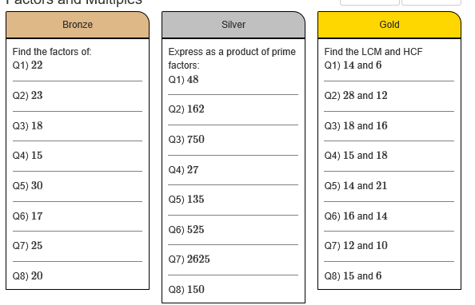

Slide 47
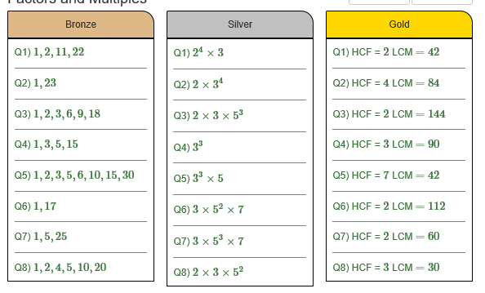

Slide 48
Using the product of prime factors and a VENN diagram
You can also put your products of prime factors in a Venn diagram, and use that to help you to calculate the HCF and LCM…
HCF – multiply only the numbers in the overlapping middle section
LCM – multiply all the numbers you can see in the Venn diagram

Slide 49
60 = 2 × 2 × 3 × 5
294 = 2 × 3 × 7 × 7
60
294
2
2
7
5
3
7
HCF of 60 and 294 =
2 × 3
= 6
LCM of 60 and 294 =
2 × 5 × 2 × 3 × 7 × 7 =
2940
Notes:
We can find the HCF and LCM by using a Venn diagram.
We put the prime factors of 60 in the first circle. Any factors that are common to both 60 and 294 go into the overlapping section.
Click to demonstrate this. Point out that we can cross out the prime factors that we have included from 294 in the overlapping section to avoid adding then twice.
We put the prime factors of 294 in the second circle.
The prime factors which are common to both 60 and 294 will be in the section where the two circles overlap.
To find the highest common factor of 60 and 294 we need to multiply together the numbers in the overlapping section.
The lowest common multiple is found by multiplying together all the prime numbers in the diagram.

Slide 50
Notes:
LINK TO VENN DIAGRAMS!

