Slide 1

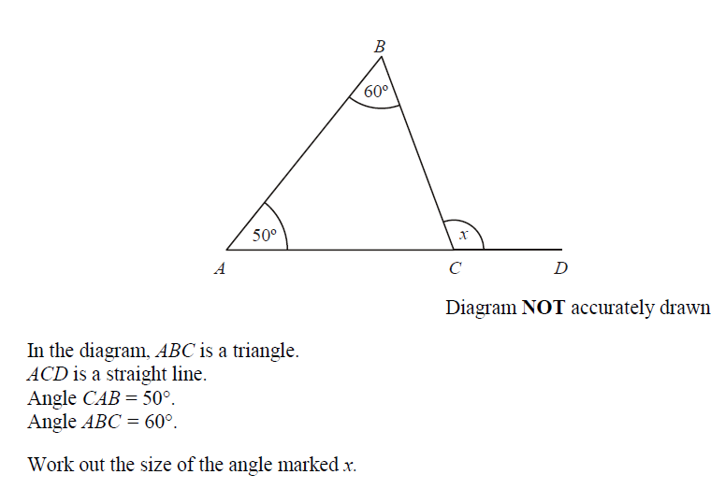


L/Q: Can I solve equations?
TIME
Power OF 3
← 5 Minute Timer →
Equations, Balance, Inverse, Solve, Expression, Variable
Keywords
L.O To be able to simplifying a ratio

Slide 2










A pair of scales is sometimes used to show equations because when both sides balance they are equal.
The scales below show that the expression 2x + 5 is equal to the quantity 21, where x is the number of marbles in each bag.
$$2x + 5 = 21$$
$$− 5$$
$$− 5$$
$$2x = 16$$
$$÷2$$
$$÷2$$
x
x
$$x =8$$
$$2x + 5$$
$$16$$
$$21$$

Slide 3



Fluency
Task - Solve
1) 3a + 6 = 15
2) 2b +5 = 21
3) 7c – 1 = 27
4) 12d – 64 = 8
a = 7
5) 3 + 6e = 15
6) 18 + 7f = 67
7) 8 = 3x – 4
8) 47 = 6x + 5
e = 2
b = 8
f = 7
c = 4
x = 4
d = 6
x = 7

Slide 4

Modelled Example
$$3x + 5 = 2x + 9$$

Slide 5
Fluency
Task -
Solve the following, laying out your working exactly as we did in the examples…
2x + 2 = x + 9
3x + 1 = x + 5
6x – 8 = 4x
5x + 1 = x - 11
x = 7
x = 2
x = 4
x = -3

Slide 6
Exam question
(a) Solve 7p + 2 = 5p + 8
p = ............................
(2)
(b) Solve 7r + 2 = 5(r – 4)
r = ...........................
(2)
(Total 4 marks)

Slide 7

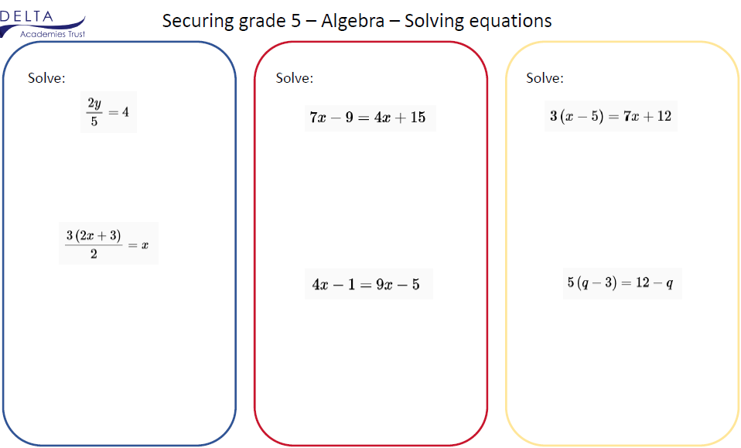
Opportunity to show Courage and Resilience
How would I solve the following questions?

Slide 8
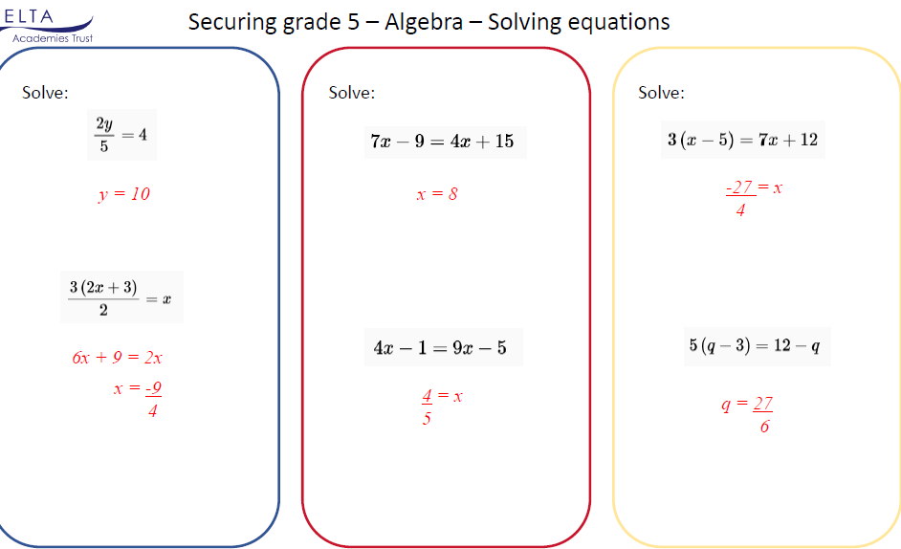

Slide 9
Please complete GSB worksheet

