Slide 1
Revision workbook
Name Class
Teacher Date issued:
Please submit work of a high quality, using full sentences. If you need more space please use lined paper.
Signed by teacher
Week 1: Mrs Birling, Mr Birling, The Birlings analysis
Week 2:Sheila, Eric, the young Birlings
Week 3: Gerald, Eva, Inspector Goole x2
Week 4: Young and Old, Morality
Week 5: Social Responsibility, personal responsibility
Week 6: Love, Inequality

Slide 2
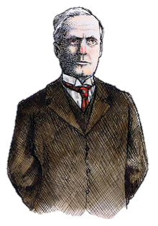
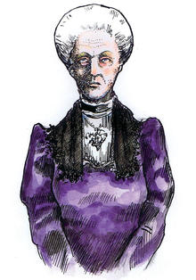
Mrs Sybil Birling
Who is she? What does she do in the play?
In the Inspector’s Investigation: What did Mrs Birling do?
What does she ask the Inspector to do to the man who got Eva pregnant? What does this tell us about her?
Mrs Birling’s actions | Why does Priestley do this?
She follows her husbands lead (passes the message onto the cook, leaves the room so the men can talk)
She speaks ‘haughtily’ and ‘rather grandly’ to the Inspector, and then boasts ‘she was the only one… who didn’t give in’
She has a key role at the Brumley Women’s Charity, yet turned down Eva’s application.
If there’s one quote to know: What does this quote tell us about Mrs Birling?
“Girls of that class”
Write an analytical paragraph on lined paper

Slide 3
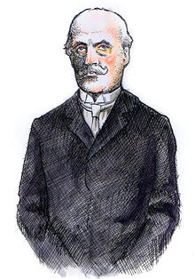
Mr Arthur Birling
Who is he? What does he do in the play?
In the Inspector’s Investigation: What did Birling do?
How does he treat the Inspector when he leaves. What does this tell us about Birling?
Birling’s actions | Why does Priestley do this?
At the start, he brags about the quality of his port and cigars.
He warns Eric and Gerald, “a man has to make his own way – has to look after himself”
He is delighted that Sheila and Gerald’s engagement has brought Crofts limited and Birling & Company together.
If there’s one quote to know: What does this quote tell us about Birling? Can you get two meanings out of him being “hard-headed”?
“I speak as a hard-headed businessman”
Write an analytical paragraph on lined paper

Slide 4
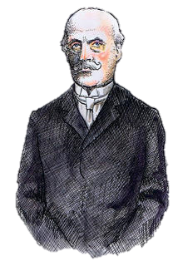
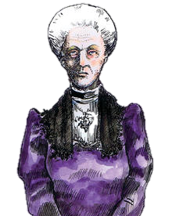
The Birlings – STRETCH Analysis
Mr Birling Key Character Traits: What do you learn about him from the following…
He is placed at ‘one end’ of the table, interrupts others and makes long speeches. | He gives orders to Sybil to praise the cook (rather then do it himself), without using the cooks name.
He has a ‘provincial’ accent, but hopes for a knighthood for being a ‘sound party man’ | He acknowledges Gerald’s mother thinks t the Birlings are socially inferior.
Mrs Birling Key Character Traits: What do you learn about her from the following…
She says about her children; “he’s only a boy” and “it would be much better if Sheila didn’t listen to this story” | She didn’t know Eric has a drinking problem, and couldn’t believe he’d have an affair.
She criticises Eva’s lover’s lack of morals. | She excuses her actions, repeating the w word ‘justified’

Slide 5
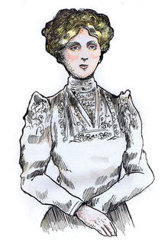
Sheila Birling
Who is she? What does she do in the play?
In the Inspector’s Investigation: What did Sheila do? Why was her class a factor in this?
How does Sheila now feel about her actions?
Sheila’s actions | Why does Priestley do this?
The opening stage directions say Sheila is ‘very pleased with life and rather excited’
She refers to Mr and Mrs Birling as ‘Mummy’ and ‘Daddy,’ yet she’s engaged to Gerald.
Whereas Arthur, Gerald and Sybil deny their responsibility, Sheila realises she cannot hid the truth.
If there’s one quote to know: What does this quote tell us about Sheila?
“Mother – I begged you and begged you to stop”
Write an analytical paragraph on lined paper

Slide 6
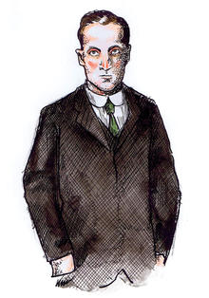
Eric Birling
Who is he? What does he do in the play?
In the Inspector’s Investigation: What did Eric do?
How does he deal with his actions?
Eric’s actions | Why does Priestley do this?
The opening stage directions say he is ‘not quite at ease’. He stops himself mid-sentence a few times.
He bursts out laughing for no reason and has a squabble with Sheila. His parents talk down to hm.
He tells both his parents that he’s never been able to talk to them: “You're not the kind of father a chap could go to when he's in trouble.”
If there’s one quote to know: What does this quote tell us about Eric?
“You killed them both – damn you, damn you”
Write an analytical paragraph on lined paper

Slide 7
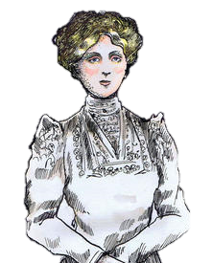
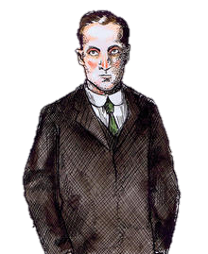
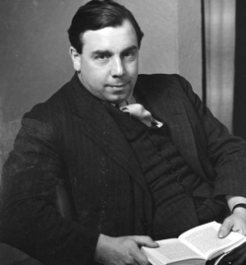
The Young Birlings – STRETCH Analysis
Sheila Key Character Traits: What do you learn about her from the following…
She focusses on her own emotions on the night, “I’ve been so happy tonight. Oh I wish you hadn’t told me” | She goes on to say about Milwards, “I feel now I can never go there again” – what do these views tell us about her upbringing?
“I know I’m to blame – and I’m desperately sorry – but I can’t believe – I wont believe – it’s simply my fault that in the end she – committed suicide” How does she feel? Does she take responsibility? What do the dashes reflect about her state of mind?
Eric Key Character Traits: What do you learn about him from the following…
He suggests Eva was right to go on strike. | When he returns in Act 3, his family do not support him, but are angry about the impending scandal. He is ‘explosively’ refused a drink.
Priestley’s Purpose: Write 2 paragraphs What is Priestley’s message through Eric and Sheila? Think about how they are different to their parents…

Slide 8
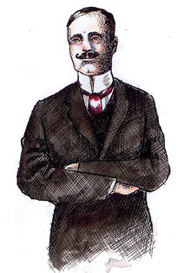
Gerald Croft
Who is he? What does he do in the play?
In the Inspector’s Investigation: What did Gerald do?
What were Gerald’s intentions? How does he feel about her death?
Gerald’s actions | Why does Priestley do this?
Gerald and Arthur agree with each other about the strike, and Arthur sticks up for Gerald after the affair is revealed.
Birling lectures Gerald, yet confides in him about his impending knighthood.
Sybil calls Gerald’s story a “disgusting affair,” whilst previously she had stopped Mrs Birling from teasing Gerald for working too much over the summer.
If there’s one quote to know: What does this quote tell us about Gerald?
“We’re respectable citizens and not criminals”
Write an analytical paragraph on lined paper

Slide 9
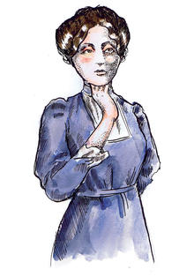
Eva Smith / Daisy Renton
Who is she? What does she do in the play?
Eva’s story demonstrates the struggles of being a woman in 1912. Where do we see the following in the play:
Dominance of men
Treatment as a sexual object
Difficulty in being independent
Prejudice about sexual activity
Eva / Daisy’s actions | What do we learn about her?
She wont take Eric’s stolen money and she organised the strike at the factory.
She never appears on stage, yet she is central to all the characters’ lives.
Before he knows how the night would unfold, Mr Birling describes her a lively, hard-working and good-looking.
STRETCH: How does this differ to the Birlings?
If there’s one quote to know: What does this quote tell us about Eva / Daisy?
“Just used her… as if she was an animal, a thing, not a person”
Write an analytical paragraph on lined paper

Slide 10
Inspector Goole
Who is he? What does he do in the play?
Priestley’s Purpose: What does Inspector Goole represent?
Inspector’s actions | Why does Priestley do this?
In the opening stage directions, he projects, “an impression of massiveness, solidity and purposefulness”
When he walks on, the lighting becomes “brighter and harder”
Despite being a lower class, he has all the power on stage (eg: he is not intimidated by Arthur or Gerald: “cutting through massively” and “cooly, looking hard at him”
If there’s one quote to know: What does this quote tell us about the Inspector’s view on responsibility?
“if men will not learn that lesson, when they will be taught it in fire and blood and anguish.”
Write an analytical paragraph on lined paper

Slide 11
Inspector Goole
Inspector Goole Key Character Traits: What do you learn about him from the following…
What does Priestley’s use of wordplay in Goole / ghoul suggest about the Inspector? | He stares at people before questioning them, only deals with one person at a time, and is clearly judgemental rather then objective.
He is like an omniscient narrator: he appears to already know everything about the Birlings. | At the end, we find out there is no Inspector Goole.
The Inspector’s Impact on the Characters: When they find out he’s a hoax, how do the characters react and what is Priestley’s message through this?
Characters | Key Quote | How have they been affected? What is Priestley’s message through this?
Arthur and Sybil (Old, middle class) | ‘[imitating Inspector] You all helped to kill her [pointing … laughing]
Gerald (Upper Class) | “What girl? There were probably four or five…”
Sheila and Eric (Young) | Sheila repeats Inspectors final words – “fire and blood and anguish”

Slide 12
Themes: Young & Old
What do the actions of the young and old reflect about their age group at different times in the play?
At the Start:
Mr Birling has the greatest number of lines, expects people to pay attention and doesn’t like to be interrupted. Mrs Birling also snaps “please don’t contradict me like that” to the children. What does this suggest about the older people?
Eric and Sheila stop squabbling when Mrs Birling tells them. Eric asks “[not to rudely]” a request.
When Goole arrives
Sybil disapprovingly notes, “You seem to have made a great impression on this child, Inspector.”
Sheila challenges her parent’s behaviour. She tells her Dad not to “interfere” with Gerald’s situation, and calls her mum “cruel and vile.” Eric is more aggressive and extreme: “damn you” and “{almost threatening her]”
When Goole leaves
Eric and Sheila have been deeply affected by the evening’s events. They challenge their parents refusal to alter their behaviour: “You’re ready to go on the same old way… and it frightens me”
The older generation mock and laugh at the Inspector. They share a relief their reputation is intact and offer no concern for Daisy Renton.
Priestley’s Purpose: What is Priestley’s message here about young and old? Is this a hopeful message for the future or not?

Slide 13
Themes: Morality
What is morality?
“We’re respectful citizens and not criminals”
How do Gerald and the Birlings believe morality is shown? Can you see an example in the play?
Priestley uses the Christian ideas of the seven deadly sins to show the characters lack of social morality, and to demonstrate how much that is exactly what Eva Smith needs. Complete the table below, just like the example…
 | Where can you see this sin demonstrated? | How does this juxtapose with the victim, Eva Smith?
Gluttony | The play opens with the table being cleared of ‘dessert plates and champagne glasses.’ Everyone drinks port. Eric’s heavy drinking. | Eva is hungry and lives in poverty. She had so little to eat that Gerald started supporting her financially.
Greed
Wrath (anger)
Envy
Pride
Lust

Slide 14
Themes: Social Responsibility
What is social responsibility?
The Inspector is the voice of social responsibility in the play. How does he present his views here…?
Inspector’s Quotes | How does this present his view on social responsibility?
“Their lives, their hopes and fears, their suffering, and chance of happiness, all intertwined with our lives…”
“She needed not only money, but advice, sympathy, friendliness”
“We’ll have to share our guilt”
“It’s my duty to keep labour costs down”
How does Arthur Birling present social responsibility?
On the Brumley Women;s Charity Organisation, Sybil helps girls with “deserving cases” – but she saw to it Eva is refused. How does she present social responsibility?
If there’s one quote to know: What does this quote tell us about Birling’s view on social responsibility?
“like bees in a hive – community and all that nonsense”
Write an analytical paragraph on lined paper

Slide 15
Themes: Personal Responsibility
The Inspector came with a mission to get everyone to understand and admit their personal responsibility for Eva’s death: a “confession” as Sheila put it.
For each character, using the quote / actions, explain their view on their personal responsibility at the end and why they feel that way.
 | Quote / Details | What’s their view on their personal responsibility?
Sheila | “I behaved badly. I know I did. I’m ashamed of it.”
Eric | “I did what I did. And Mother did what she did. And the rest of you did what you did to her”
Gerald | After being remorseful and guilty with the Inspector, at the end he asks Sheila to stay engaged to him and doubts the story of Eva’s death.
Mr Birling | They both explain and justify their actions throughout, never admitting any wrongdoing. When they prove the Inspector is fake, they laugh and joke about the night’s events.
Mrs Birling
Priestley’s Purpose: After these conversations, Priestley has the phone ring again with news an Inspector is on his way. Write a response on lined paper to show how this reflects his message on personal responsibility?

Slide 16
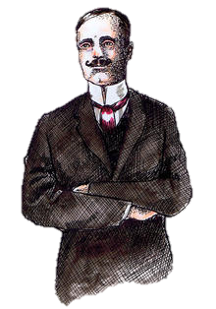
Themes: Love
Sheila and Gerald
Why is Mr Birling so happy about this engagement? What is implied about their romance?
The play opens with the Birlings celebrating Sheila and Gerald’s engagement: but how is their love presented?
Engagement Quotes | How does this present their love?
Sheila talked ‘[gaily]’ and in a ‘[playful]’ manner.
Gerald says, “and I drink to you – and hope I can make you as happy as you deserve to be”
To the ring, Sheila says “Now I feel really engaged”
Girls vs Boys
The characters’ view on love is shaped by their gender. How is their view on love presented in the following:
Eric says of Eva, “She was pretty and a good sport”
Gerald says Eva, “became at once the most important person in her life.”
Gerald admits about Eva “I didn’t feel about her as she felt about me”
Sheila says Gerald was “the wonderful Fairy Prince”

Slide 17
Themes: Inequality
Why does Eva Smith suffer from such inequality?
Priestley’s key message is about the inequality in society. Eva’s lifestyle was completely shaped by her inequality, whereas the Birlings massively benefitted from the social inequality that existed.
In the table below, explain how Eva Smith’s experience and The Birling’s experience juxtaposed because of their inequality. The first one has been done for you…
 | Eva Smith | The Birlings
Gaining Employment | Arthur asks if after she was sacked if she “got into trouble? Go on the streets?” – thereby suggesting that there was no other option of her but to turn to crime or prostitution as a means of making money. | Mr Birling had the luxury of removing peoples employment whenever he felt it in the best interest of the company.
Personal Relationships
Keeping Employment
Living Arrangments
Democracy and Elections
Priestley’s Purpose: What do you think is Priestley’s message about inequality – as presented through the Inspector. Write 2 -4 paragraphs in response

