Slide 1
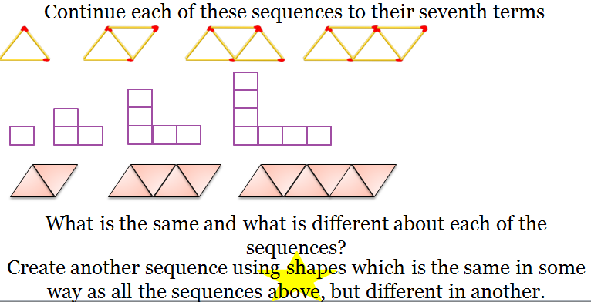
Finding an expression for the nth term rule
LQ: Can I find an expression for the nth term rule?
PLQ: Can I recognise sequences by their expressions?
← 5 Minute Timer →
Do it Now
Prepare For Learning
KW: Sequence, Term, Expression, nth term, Increase
Notes:
Students work in silence. Start the Timer for students to write down non-negotiables and to see who is late.
1. All Students copy down Title, LQ, PLQ, Date
2. All students write down Key Words
3. All students write attempt Do it Now

Slide 2
LQ: Can I find an expression for the nth term rule?
PLQ: Can I recognise sequences by their expressions?
What are we learning today?
What? Creating a mathematical rule for a number pattern. | How? Looking at picture patterns, then number patterns. | Why? So we can find any term in a sequence that we need to! E.g. How many bricks you need to build a house.
Agree Learning Outcomes
KW: Sequence, Term, Expression, nth term, Increase
Notes:
1. LQ and PLQ presented to class and analysed
2. What / How / Why - Topic
3. Key words discussed with class - Literacy

Slide 3
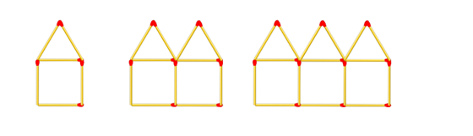
Do you understand this new topic?
Can you draw the next term in the sequence?
How many matchsticks in each term?
Can we spot a pattern?
How many match sticks will there be in the next term?
How many matchsticks will there be in the 10th, 50th and 100th term?
Present New Information
KW: Sequence, Term, Expression, nth term, Increase
Notes:
New Content Explained.
Low Ability – Further Explanations and Examples on Board
Middle Ability – Explanations and Student Engagement
High Ability – Present and encourage student led conversations / Discussions

Slide 4
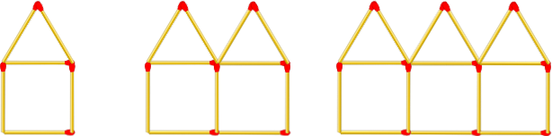

1 Minute for Discussion
The 2nd pattern has 11 matchsticks.
The 20th pattern will be 10 × 2nd pattern.
So the 20th pattern will have 110 matchsticks.
Do you agree? Discuss in pairs.
Present New Information
KW: Sequence, Term, Expression, nth term, Increase

Slide 5
Do you understand this new topic?
n = number of terms
When n = 1, the answer is 6
When n = 2, the answer is 11
1st Term | 2nd Term | 3rd Term | 4th Term | n^{th} term
6 | 11 | 16 | 21
+ 5
+ 5
+ 5
As the numbers increase by 5. Our expressions will begin with 5n.
What are we doing to get the next term?
How would we write the nth term?
5n + 1
Present New Information
KW: Sequence, Term, Expression, nth term, Increase
Notes:
New Content Explained.
Low Ability – Further Explanations and Examples on Board
Middle Ability – Explanations and Student Engagement
High Ability – Present and encourage student led conversations / Discussions

Slide 6
Do you understand this new topic?
4, 7, 10, 13, 16….
n = number of terms
1st Term | 2nd Term | 3rd Term | 4th Term | 5th term
4 | 7 | 10 | 13 | 16
1st Term | 2nd Term | 3rd Term | 4th Term | n^{th} term
6 | 11 | 16 | 21
What are we doing to get the next term?
How would we write the nth term?
Present New Information
KW: Sequence, Term, Expression, nth term, Increase
Notes:
New Content Explained.
Low Ability – Further Explanations and Examples on Board
Middle Ability – Explanations and Student Engagement
High Ability – Present and encourage student led conversations / Discussions

Slide 7
Can you demonstrate what you have learned?
HINGE QUESTION
Find the nth term rule for this sequence: 5, 9, 13, 17…
← 30 Seconds →
2n+9
n+5
4n
4n+1
Reviewing Learning
KW: Sequence, Term, Expression, nth term, Increase
Notes:
Hinge Question:
Pupils Attempt question in Silence without the 4 multiple choice
Timer set on for students
Pupils look at the selection of answers and remember A, B, C or D

Slide 8
Can you demonstrate what you have learned?
HINGE QUESTION
Find the nth term rule for this sequence: 5, 9, 13, 17…
Bronze
Bronze
Silver
Answer B.
Answer B.
Answer A.
Bronze
Silver
Silver
Gold
Answer A.
Answer A.
Answer C.
Answer D.
Reviewing Learning
KW: Sequence, Term, Expression, nth term, Increase
Notes:
Students see their answers here which relate to the activity they will do on the next slide.
PowerPoint Tip – Move the Bronze, Silver, Gold bas around to the answers. The animations are already put in.

Slide 9
Can you develop understanding about this topic?
← 10 Minutes →
Bronze Task
Write the next 3 terms in the sequence.
What are we doing each time to get the next term?
2,4,6,8,10…
3,6,9,12,15…
1, 2, 3, 4, 5…
5,10,15,20…
3, 6, 9, 12…
4, 8, 12, 16…
Silver Task
Write the nth term rule for each sequence.
6,12, 18…
4, 8, 12, 16…
10, 20, 30, 40…
9, 18, 27…
11, 22, 33, 44, 55…
12, 24, 36, 48..
15, 20, 25, 30..
Gold Task
Write the nth term rule for each sequence.
3, 5, 7, 9….
4,7,10, 13, 16,…
19, 13, 7…
5, 9, 13…
3, 10, 17, 24…
7, 9, 11, 13, 15
4, 8, 12, 16…
Extension – PLQ Challenge
Construct Meaning
KW: Sequence, Term, Expression, nth term, Increase
Notes:
All pupils attempt the task at their level from the Hinge Question. Pupils who are on Bronze only have a small amount of time to achieve the Bronze Task.
Bronze – Copying down further examples and relooking over to see if they understand.
Silver – Construct meaning towards the LQ
Gold – Pupils will have achieved the LQ and will be working towards the PLQ. Pupils can attempt the PLQ Challenge after this (To be printed)

Slide 10

Can you extend your understanding?
Extension – PLQ Challenge
Write the nth term rule for each sequence.
6, 11, 16, 21 ….
20, 33, 46…
305, 309, 313, 317…
1017, 1028, 1039…
20, 11, 2, -7…
47, 58, 69…
-4, -8, -12, -16…
Construct Meaning
KW: Sequence, Term, Expression, nth term, Increase
Notes:
PLQ Challenge after Gold Tasks / Apply work. Can be further Apply Tasks if there is time. Ideally printed.

Slide 11
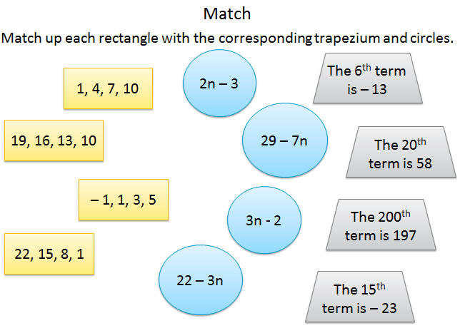
Can you apply what you have learned?
Extension
Write down 3 examples where:
You can find the nth term rule
Where you cannot find the nth term rule
Apply To Demonstrate
KW: Sequence, Term, Expression, nth term, Increase
Reviewing Learning
Notes:
Opportunity for whole class Apply tasks – Exam style / Worded questions
Pupils can also attempt the PLQ Challenge as an extension to the learning.

Slide 12
Can you demonstrate what you have learned?
Exit Ticket
Q1) 2,4,6,8 What is the nth term?
Q2) Write the next 3 terms 6, 9, 12…
Q3) 6, 11, 16… What is the nth term?
Q4) 2,4,6,8 What is the nth term?
Q5) What are the first 3 terms in the sequence? 3n+1
Extension
Reviewing Learning
KW: Sequence, Term, Expression, nth term, Increase
Notes:
All students complete Exit Ticket. Pupils write down Q1 – Q5 in their books and answer the questions.
Extension – Could be an open ended / creative task, such as “how would you explain this topic to a Year 4 student?” or “create 5 questions for your partner” or “How could we apply this to….?”

Slide 13
What have you learned today?
LQ: Can I find an expression for the nth term rule?
PLQ: Can I recognise sequences by their expressions?
Reviewing Learning
KW: Sequence, Term, Expression, nth term, Increase
Notes:
Finally recap the learning from the LQ and PLQ. Opportunity for AfL.

