Slide 1
VERTICAL, HORIZONTAL AND PARALLEL LINES

Slide 2
What do these coordinate pairs have in common?
(2, 3), (2, 1), (2, –2), (2, 4), (2, 0) and (2, –3)?
Look what happens when these points are plotted on a graph.
y
This line is called x = 2.
x
x = 2

Slide 3
I can work out Vertical Equations of Lines
Fluency
y
x
x = –10
x = –3
x = 4
x = 9
How does this change when the lines are Horizontal ?

Slide 4
What do these coordinate pairs have in common?
(0, 1), (3, 1), (–2, 1), (2, 1), (1, 1) and (–3, 1)?
Look what happens when these points are plotted on a graph.
y
This line is called y = 1.
y = 1
x

Slide 5
I can work out and Horizontal Equations of Lines
Fluency
y
y = 5
y = 3
x
y = –2
y = –5
How is the equation of a line linked to Transformations?
How do these lines vary from y = x and y = -x

Slide 6
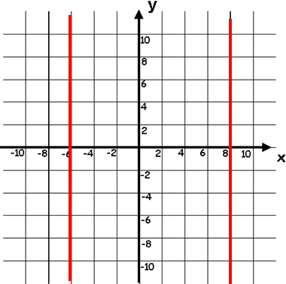
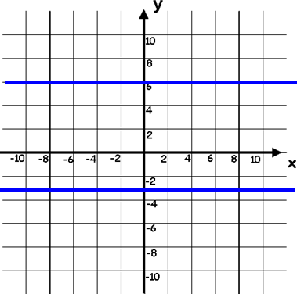
I can work out Vertical and Horizontal Equations of Lines
Fluency
AFL Task – Write down the equation of each of these lines
1)
2)
3)
4)

Slide 7
Parallel graphs have the same gradient.
The gradients of perpendicular graphs are negative reciprocals of each other (their product is -1).
The y-intercept is where the graph cuts the y-axis.
The x-intercept is where the graph cuts the x-axis.

Slide 8
I can work out intervals on a number line
Fluency
Which graph is parallel to y = 3x + 6
y = 1/3x + 4
y = -3x - 6
y = 3x - 2
y = -1/3x + 6
Which graph has the same y-intercept as to y = 3x + 6
y = 1/3x + 4
y = -3x - 6
y = 3x - 2
y = -1/3x + 6
Which graph is perpendicular to y = 3x + 6
y = 1/3x + 4
y = -3x - 6
y = 3x - 2
y = -1/3x + 6
Reasoning
Find the equation of the line which is parallel to y = 2x + 4 and passes through the point (7, 3).
y = 2x + c
7 = 2(3) + c
Can you spot the error in this working out and explain the correct process?
7 = 6 + c
1 = c
y = 2x + 1

Slide 9
L/Q:
TIME
Power OF 3
← 5 Minute Timer →
Gradient, Intercept, Straight Line, Co-ordinates, Plot, Substitution, Parallel, Perpendicular, Reflection
Keywords
L.O To be able to simplifying a ratio

Slide 10
COORDINATES ON LINES

Slide 11
How do you know if a coordinate point is on a line?
Use must use substitution to solve
You can work out the $x$coordinate from the $y$
Alternatively, you can work out the $y$ coordinate from the $x$
EXAMPLE
Coordinates are written (x , y)
Given the equation y = 2x + 2.
Is (1, 3) a coordinate on the line.
Use the information and substitute into the equation.
Does 3 = (2 x 1) + 2 ?
If it does not, then this coordinate point is NOT on the line

Slide 12
I can work out whether coordinate point is on a line
Fluency
Task – Match coordinates
$$y = 2x + 1$$
( 5 , 23 )
( 4 , 4 )
$$y = 4x + 3$$
( 3 , 11 )
$$y = 3x$$
$$y = 2x − 4$$
( 3 , 7 )
( 2 , 6 )
$$y = 6x − 1$$
( 1 , 5 )
$$y = 3x + 2$$

Slide 13
I can work out intervals on a number line
Reasoning
y = 2 + 3x
( 2 , 8 )
Lies on the line
Does not lie on the line
How does this equation of a line vary?
Can equations of a line be written in this format?

Slide 14
L/Q:
TIME
Power OF 3
← 5 Minute Timer →
Gradient, Intercept, Straight Line, Co-ordinates, Plot, Substitution, Parallel, Perpendicular, Reflection
Keywords
L.O To be able to simplifying a ratio

Slide 15
PLOTTING STRAIGHT LINE GRAPHS

Slide 16
Where might you already be using straight lines?
In reality, this is inaccurate, as each player occupies a range of coordinates rather than just one
What designers then did was to model each player as a circle
A circle has an equation which could look like this
(x – 4)² + (y + 1)² = 30
→ The computer will then effectively check whether the circle equation and the line equation have any ‘common coordinates’
Both players can be modelled as coordinates
Based on the angle of the shot, the computer will calculate the equation of the line
It will then check whether the equation intersects with the second coordinate
If it does, then the computer knows there was a ‘hit’
Often in video games, computers have to work out whether objects ‘collide’
For example, trying to hit a ball with a baseball bat
Or trying to throw something to or at another player
How might the computer do this?

Slide 17
Example:
Draw the graph of y = x + 2
Step 2: We use our table of coordinates to plot each point on a set of axes...
Step 3: Join these points to form a straight line
x | 0 | 1 | 2 | 3 | 4 | 5
y | 2 | 3 | 4 | 5 | 6 | 7
Once the table is complete, plot on the grid and join the points, creating a straight line
6
5
4
3
2
1
0
1
2
3
4
5
6

Slide 18
I can work out intervals on a number line
Fluency
Draw the following graphs
1) y = 2x + 1 2) y = 3x – 2 3) y = 2x – 1
y = x + 4 5) y = x – 3 6) y = 3x + 1
y = - 2x + 3 8) y = 3 – x 9) y = -3x – 1
y = $\frac{1}{2}$x + 3 11) y = $\frac{1}{3}$x – 2 12) y = $\frac{1}{4}$x
y = $\frac{2}{3}$x + 2 14) y = 2 – $\frac{1}{2}$x 15) y = -x
Reasoning
Problem Solving

Slide 19
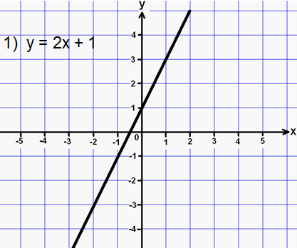
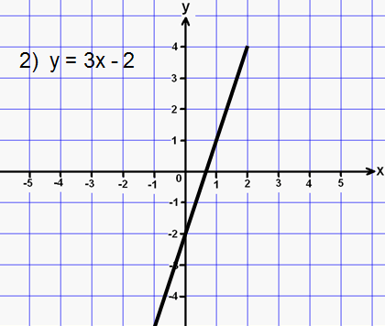
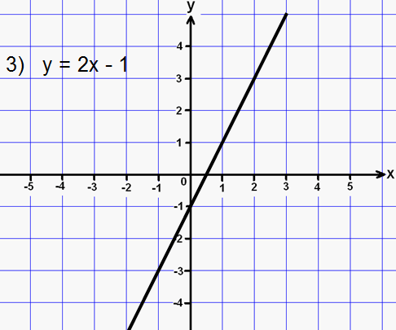
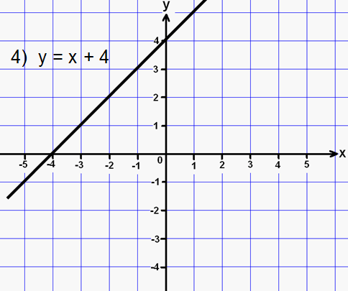
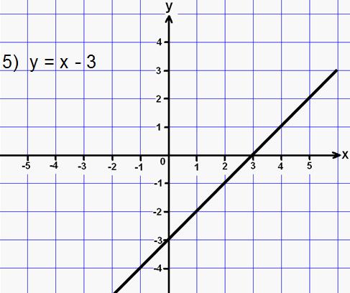
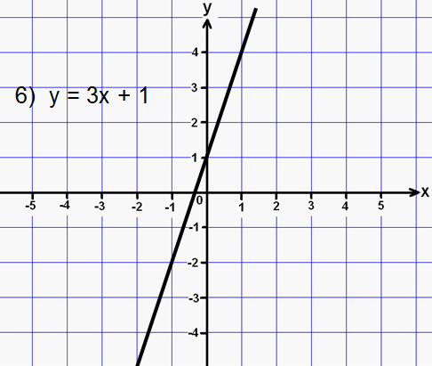
Solutions - BRONZE

Slide 20
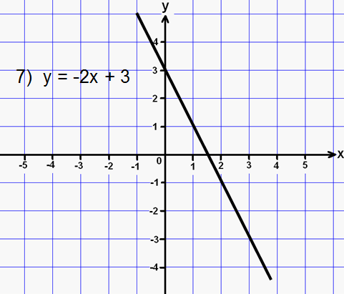
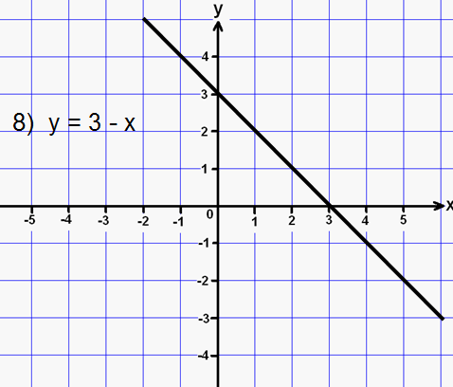
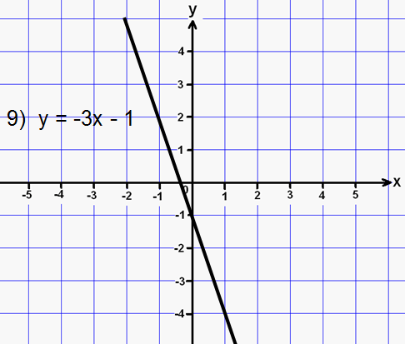
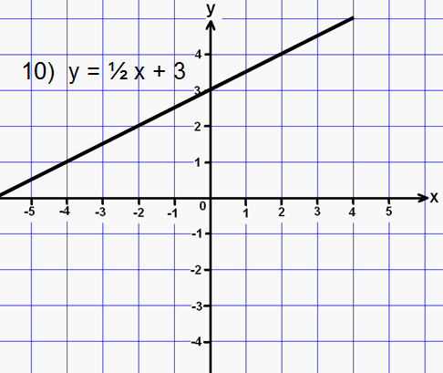
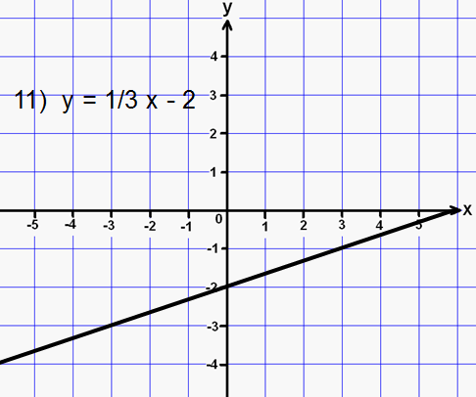
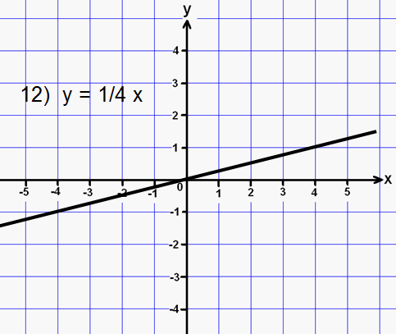
Solutions - SILVER

Slide 21
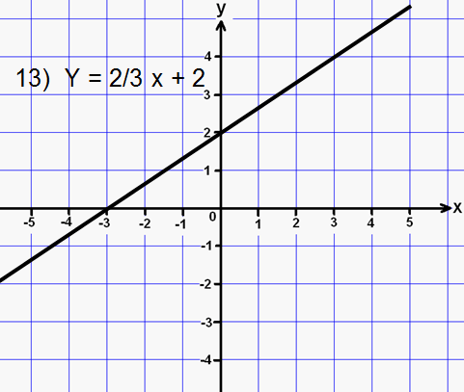
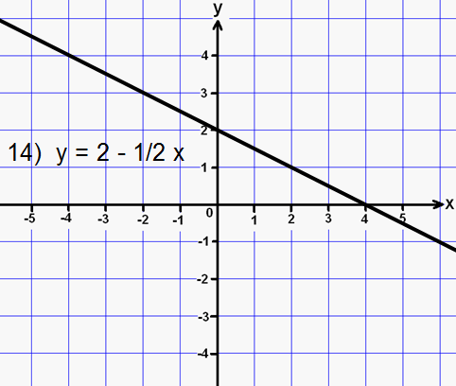
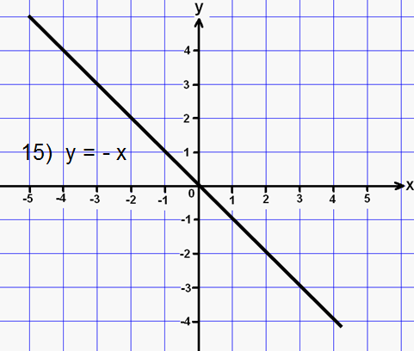
Solutions - GOLD

Slide 22
