Slide 1
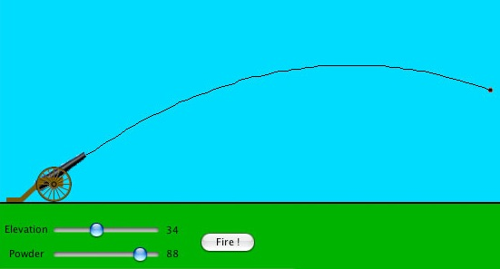
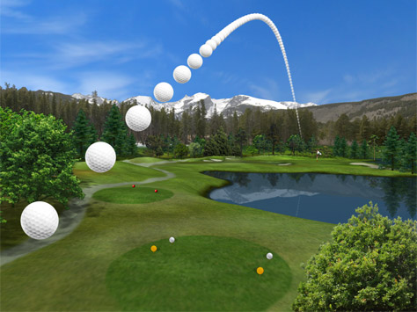
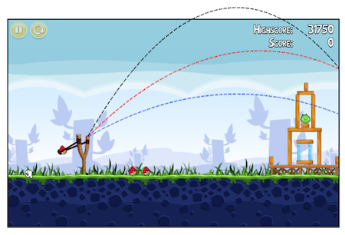
PLOTTING QUADRATIC GRAPHS

Slide 2
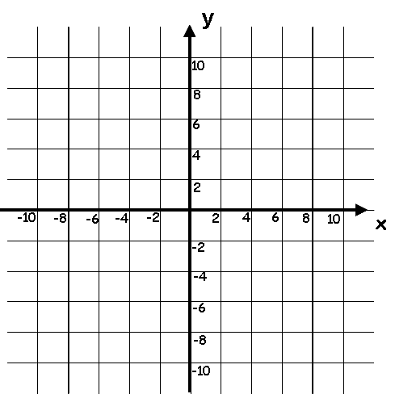
Example:
Plot the graph of the equation $y = x2 + 1$
Step 2: We use our table of coordinates to plot each point on a set
Step 3: Join these points to form a straight line
x
-3
-2
-1
0
1
2
3
x²
9
4
1
0
1
4
9
x² + 1
10
5
2
1
2
5
10
y = x² + 1
Note: these will be your value for $y$
Once the table is complete, plot on the grid and join the points, by free hand to create a curved line

Slide 3
I can work out intervals on a number line
Fluency
$$y = x2 + 2x \text{y}\text{ = }\text{x}\text{2 }–\text{ 4} \text{y}\text{ = 2}\text{x}\text{2}$$
$y =10 − x2$ y = x² - 3x y = 5x – x²
$\text{y}\text{ = }\text{x}\text{2}\text{ + 4}\text{x}\text{ + 7}$ y = 10 – 2x – x²
Reasoning
Problem Solving

Slide 4
I can work out intervals on a number line
Fluency
Reasoning
Problem Solving

Slide 5
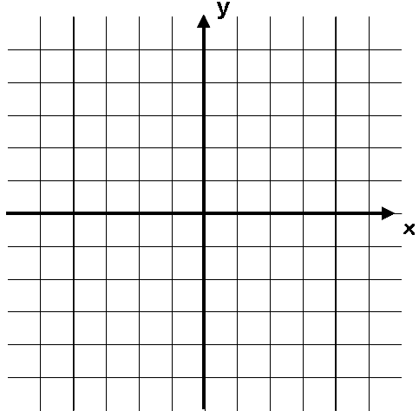
Gradients on a curved graph
You have already seen how to calculate the gradient of a linear graph by dividing the change in $y$ by the change in $x$
Also known as ‘rise over run’
What if you were asked to calculate the gradient of this line?
The problem on a curved line is that the gradient is different depending on where on the line you are…
On the left side, the gradient will be negative
On the right side, the gradient will be positive
However, we can use a technique to estimate the gradient, using what you already know…
Line is downward sloping so the gradient is negative
Line is upward sloping so the gradient is positive

Slide 6
Gradients on a curved graph
Draw a straight line that just touches the curve where x = 2
This line is known as a tangent to the curve
You can calculate the gradient of it like on a straight line graph
The value will be an estimate of the gradient of the curve at the given point
Estimate the gradient of this line where $x = 2$
5
2.2
x = 2
2
-5
5
$$Gradient=\frac{rise}{run}$$
$$Gradient=\frac{2.2}{2}$$
-5
$$Gradient=1.1$$

Slide 7
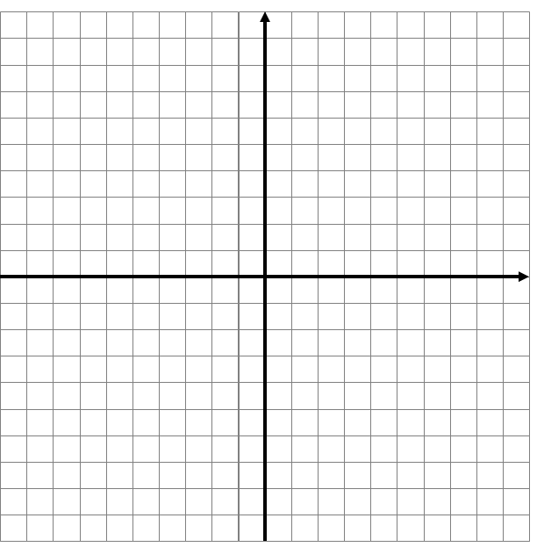
Plenary
f) y = x³ – 4x² + 8x
Find the gradient where x = 2

Slide 8
L/Q:
TIME
Power OF 3
← 5 Minute Timer →
Gradient, Intercept, Straight Line, Co-ordinates, Plot, Substitution, Parallel, Perpendicular, Reflection
Keywords
L.O To be able to simplifying a ratio

Slide 9
$$y=mx+c$$

Slide 10
$y$ = m$x$+ c
All straight lines have equations which can be written in the form:
$y$ = m$x$ + c
m is the GRADIENT (for each 1 unit right, how many units up?)
c is the $y$-INTERCEPT (where does the graph cut the $y$-axis?)
If the equation doesn’t look like this, REARRANGE it so$y$is the subject

Slide 11
Gradient
Gradient means steepness of the slope
‘For every one to the right I go up m’
The gradient, ‘m’ is always the coefficient of $x$ (the number attached to the $x$ in the equation)
$y$= 3$x$ + 2 gradient is 3
So for every 1 across to the right, I go UP 3
$y$ = -4$x$ - 1 gradient is -4
So for every 1 across to the right, I go DOWN 4
$y$ = 2 + 7$x$ gradient is 7
So for every 1 across to the right, I go UP 7

Slide 12
$y$-intercept
Intercept sounds like intersect, which means meet or cross
‘Where does the graph meet or cross the y-axis?’
The $y$-intercept is the number with no letter attached to it
$y$= 3$x$ + 2 intercept is at 2
So the graph crosses y at the point (0 , 2)
$y$ = -4$x$ - 1 intercept is at -1
So the graph crosses y at the point (0 , 4)
$y$ = 2 + 7$x$ intercept is at 2
So the graph crosses y at the point (0 , 2)

Slide 13
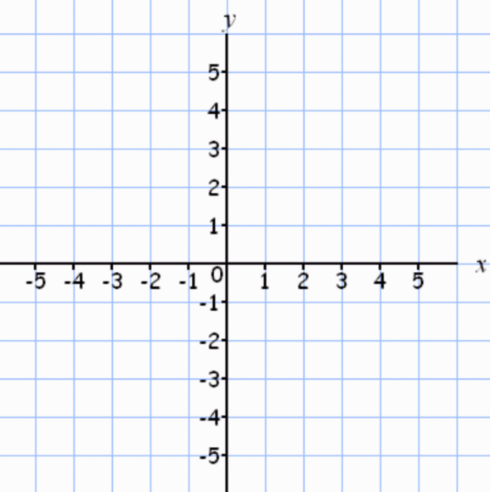
Example
$y$ = 3$x$ + 2
$y$ = 3$x$ + 2
gradient 3
3
$y$-intercept (0,2)
(0,2)

Slide 14
I can work out intervals on a number line
Fluency
Task – Complete the table
equation | gradient | y-intercept
y = 3x + 4
y = – 5
y = 2 – 3x
 | 1
 | –2
3
(0, 4)
x
1
2
(0, –5)
2
–3
(0, 2)
y = x
(0, 0)
y = –2x – 7
(0, –7)

Slide 15
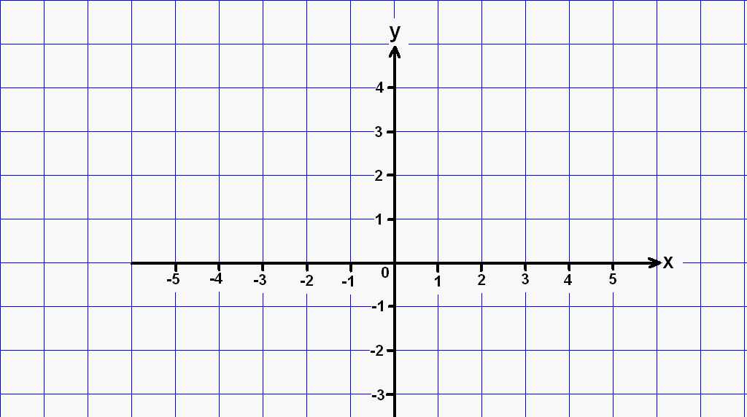
I can work out intervals on a number line
Reasoning
AFL Task – Find the equations of lines
y = - x + 1
y = - 2x + 3
y = 2x + 1
3)
1)
2)
5)
y = 2x - 1
y = -$\frac{1}{2}$x - 1
6)
y = $\frac{1}{2}$x - 2
4)

Slide 16
L/Q:
TIME
Power OF 3
← 5 Minute Timer →
Gradient, Intercept, Straight Line, Co-ordinates, Plot, Substitution, Parallel, Perpendicular, Reflection
Keywords
L.O To be able to simplifying a ratio

Slide 17
$$\text{C}\text{alculate} \text{the} \text{Gradient} \text{between} \text{points}$$

Slide 18
Gradients
The gradient (slope) of a line can be positive, negative or zero
an upwards slope
a horizontal line
a downwards slope
y
y
y
x
x
x
Positive gradient
Zero gradient
Negative gradient
If a line is vertical its gradient is UNDEFINED

Slide 19
Working out the gradient
y
(x₂, y₂)
change in y
the gradient =
change in x
y₂ – y₁
(x₁, y₁)
x₂ – x₁
y₂ – y₁
the gradient =
x₂ – x₁
x

Slide 20
Example 1
To find the gradient of a line between two points, we need to divide the DIFFERENCE IN Y by the DIFFERENCE IN X.
(Difference in y) ÷ (Difference in x) = Gradient
Find the gradient between (1,2) and (6,12)
Find the difference between the y values.
12 -2 =10
Find the difference between the x values.
6 -1 =5
Divide the difference in y by the difference in x
10÷5=2

Slide 21
Example 2
To find the gradient of a line between two points, we need to divide the DIFFERENCE IN Y by the DIFFERENCE IN X.
(Difference in y) ÷ (Difference in x) = Gradient
Find the gradient between (-3,8) and (1,12)
Find the difference between the y values.
12 -8 =4
Find the difference between the x values.
1 --3 =4
Divide the difference in y by the difference in x
4÷4=1

Slide 22
I can work out intervals on a number line
Problem Solving
Task - Work out the gradients between the following pairs of points…
(1, 1) and (3, 3)
(0, 4) and (4, 0)
(2, 1) and (4, -11)
(10, 3) and (16, -5)

Slide 23
I can work out intervals on a number line
Fluency
1) Find the gradient between the points:
(3,5) and (4,7)
(5,9) and (7,17)
(4,6) and (5,7)
(1,4) and (4,19)
(0,11) and (4,23)
2) Find the gradient between these points:
(2,5) and (3,-3)
(2,8) and (3,2)
(4,8) and (8,4)
(8,15) and (6,33)
(7,12) and (4,42)
(4,8) and (3,14)
3) Find the gradient between these points:
(3,5) and (4,5.5)
(5,9) and (7,8)
(4,6) and (5,6.75)
(1,4) and (4,4.75
(0,11) and (4,11.4)
Answers
2
4
1
5
3
-8
-6
0
-1
-10
-6
0.5
-0.5
0.75
0.25
0.1

Slide 24
I can work out intervals on a number line
Fluency
AFL

