Slide 1
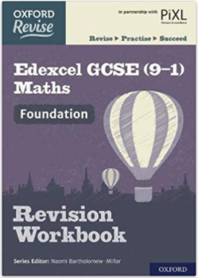
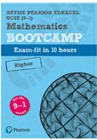
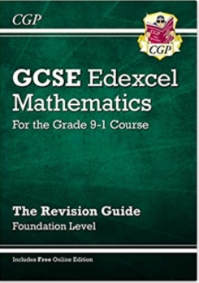
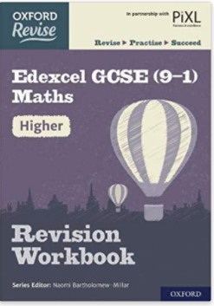
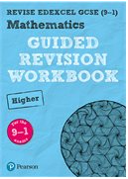
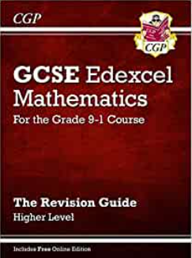
Maths Revision Techniques
Regular Practice
Research suggest that 66% of material is forgotten after only 7 days.
Research also suggest 88% of material is forgotten after 6 weeks.
Reading notes and textbooks leads to just 10% retention, this is why regular practice is vital for recall.
Useful Websites
Hegarty Maths
https://hegartymaths.com/
Revision Booklets
www.tannermaths.co.uk
Revision Mats
www.accessmaths.co.uk/revision
GCSE Questions by Topic
www.maths4everyone.com
Exam Paper Practice
www.mathsgenie.co.uk/papers
Electronic Exam Paper
www.onmaths.com
Revision Worksheets
www.drfrostmaths.com
Retrieval Practice
www.corbettmaths.com/5-a-day/
Essential Exam Support
www.justmaths.co.uk
Exam Information
Exam Board – Edexcel 1MA1
Exam – 3 papers, each lasting 1.5hrs with 1 non-calculator & 2 calculator paper
Exam Dates – 25/05 – 08/06 –15/06
Highly Recommended Revision Books & Websites to Purchase
Oxford Revise: Edexcel GCSE (9-1) Maths Revision Guide
www.amazon.co.uk/Oxford-Revise-Edexcel-Revision-Workbook
Revise Edexcel GCSE (9-1) Mathematics
www.pearsonschoolsandfecolleges.co.uk/secondary/Mathematics/
GCSE Maths Edexcel Revision Guide: - for the Grade 9-1 Course
www.amazon.co.uk/GCSE-Maths-Edexcel-Revision-Guide

