Slide 1
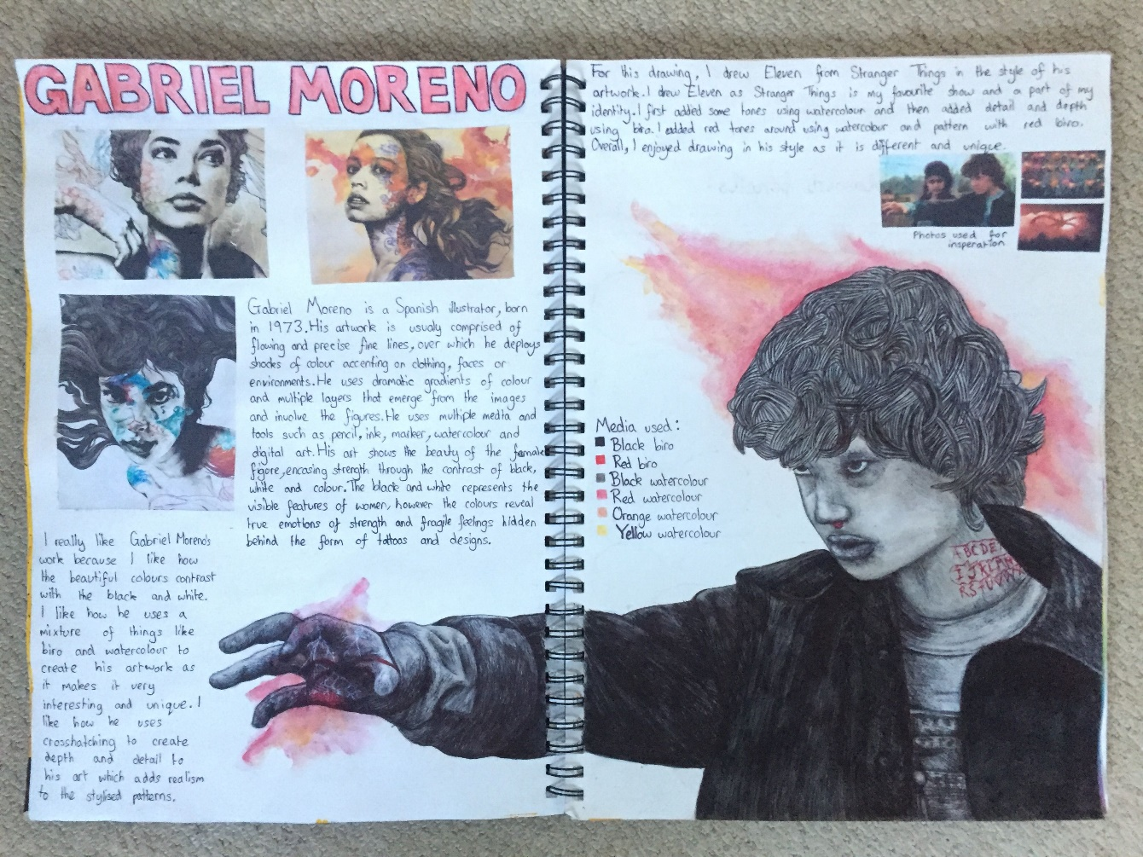
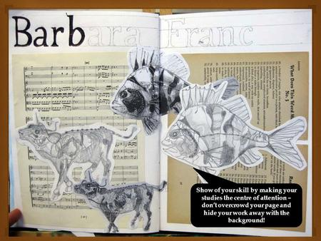
YEAR 10 COURSEWORK; ART
We are on ASSESSMENT OBJECTIVE 3 (AO3)
Inspirations page
3rd artist investigation to inform planning
Obs. Drawings for planning
4 ideas
Fiind your own artist. Create an investigation page to include written response and an ‘in the style of’.

