Slide 1
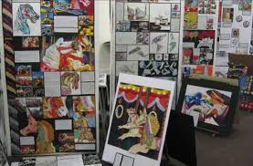
YEAR 11 COURSEWORK; ART
We are on ASSESSMENT OBJECTIVE 3 and 4 (AO3/ AO4)
Inspirations page
3rd artist investigation to inform planning
Obs. Drawings for planning
4 ideas
Colour plan
Select one of the above tasks to compete fully while at home.

