Slide 1
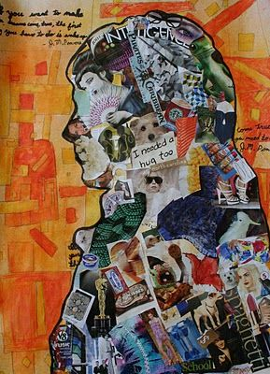
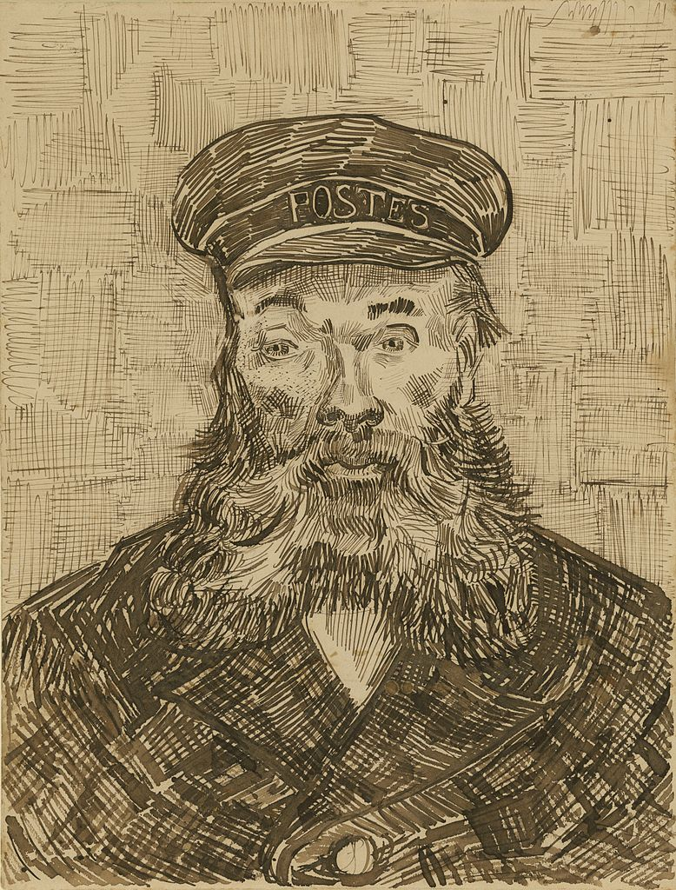
YEAR 7 HOME LEARNING; ART
Collage
7x1, 7x2, 7x4, 7x5, 7x6
Complete the collage homework set last lesson.
Your collage must have
-images that represent you
-your personality
-your likes and hobbies
7x3
Complete the worksheet on Vincent Van Gogh,
making a detailed study of ‘The Postman’.
‘The Postman’
To be completed be ALL YEAR 7s- Progression task
Print and complete worksheet on ‘line’ (second slide).

Slide 2
