Slide 1
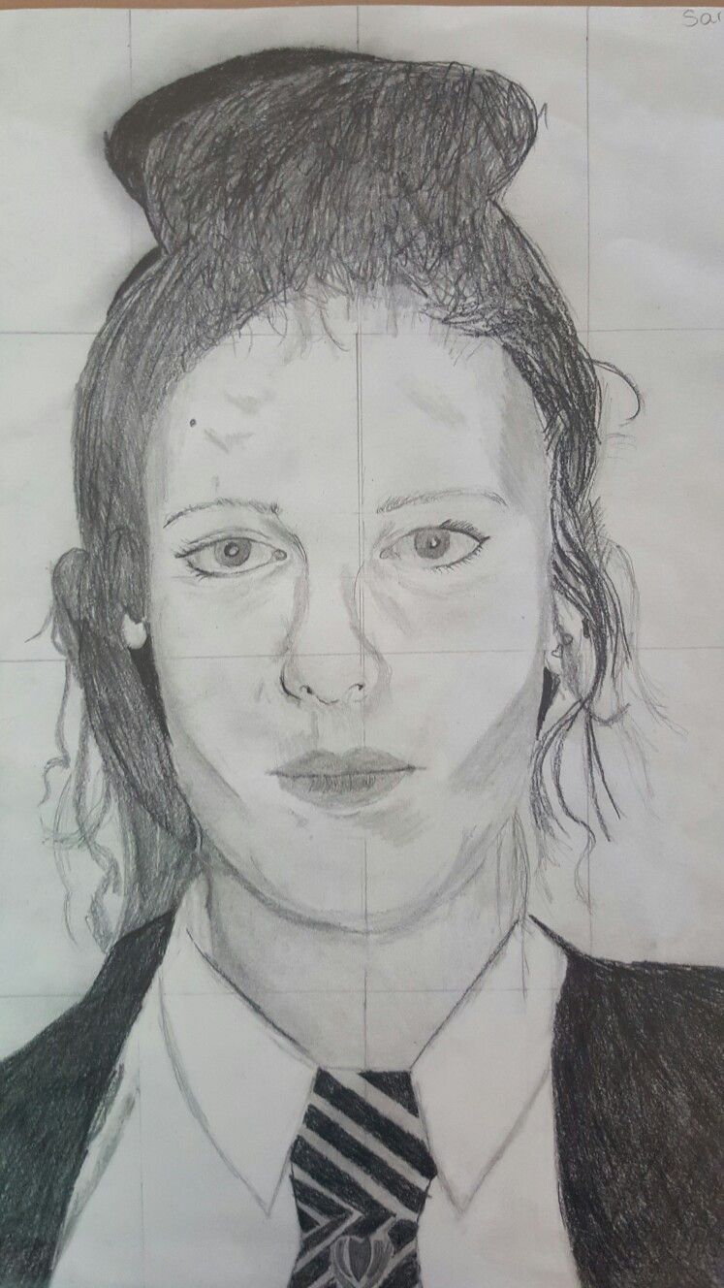
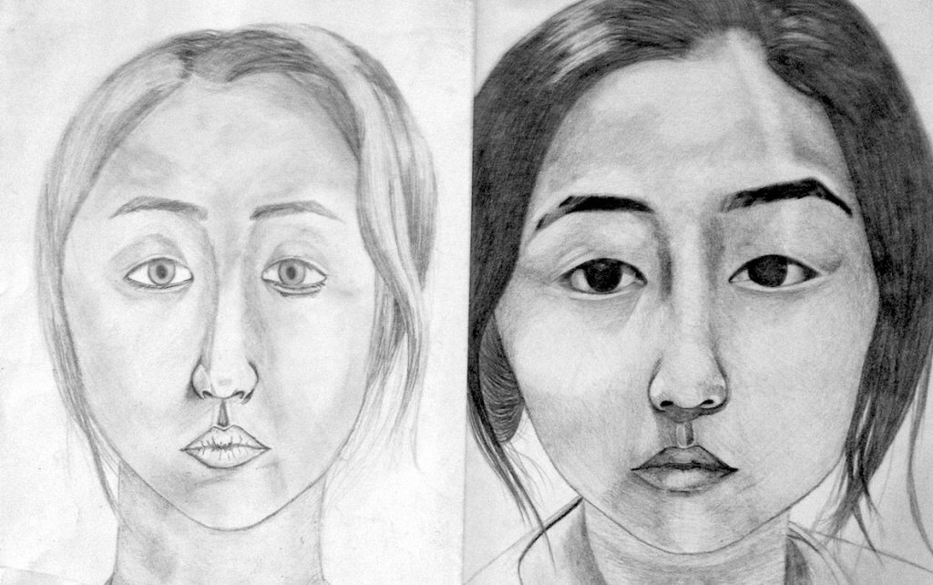
YEAR 8 HOME LEARNING; ART
We have been learning about portraiture drawing!
Make a pencil study of yourself. Add tonal detail
showing very light to very dark shades.
Progression Task:
Create a portrait of a family member

