Slide 1
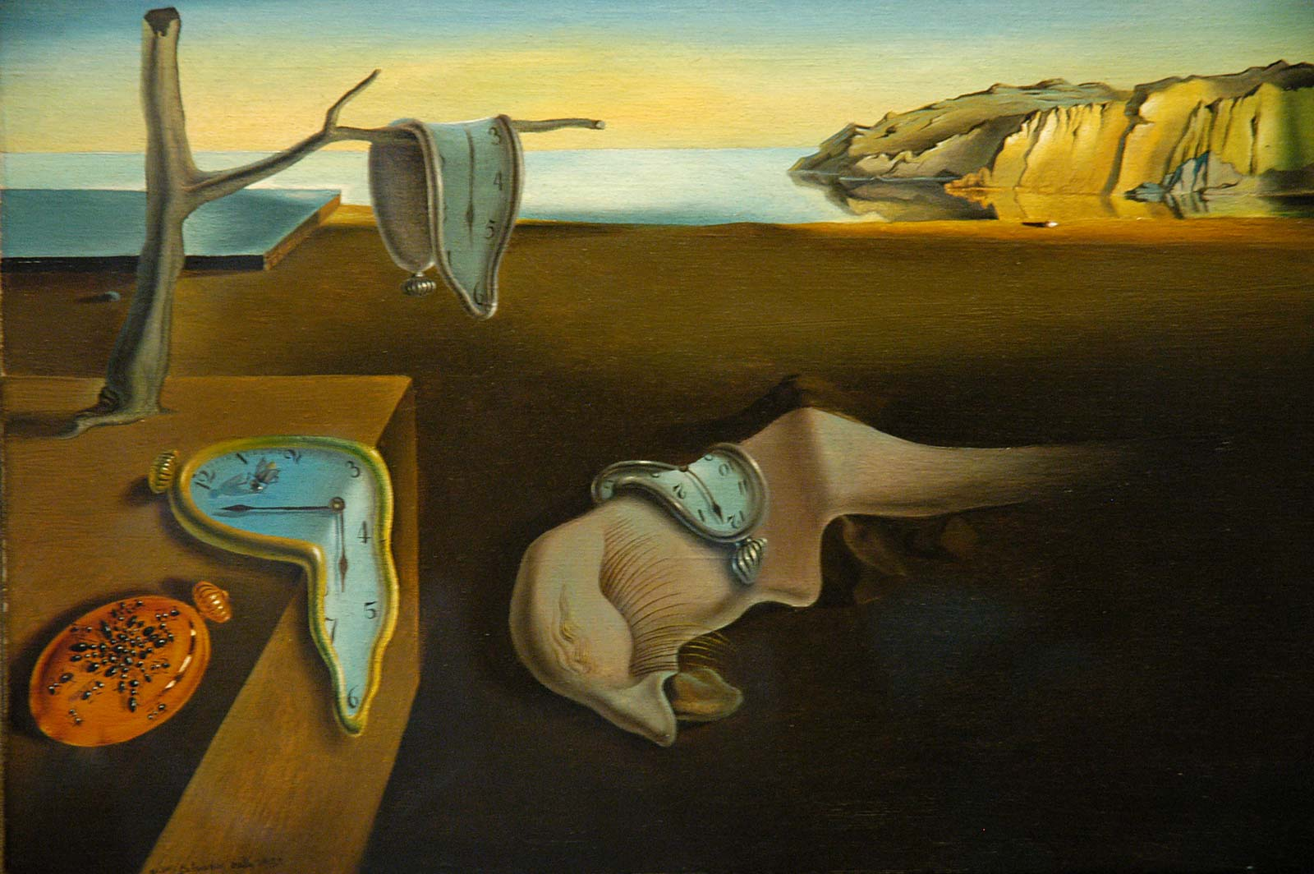
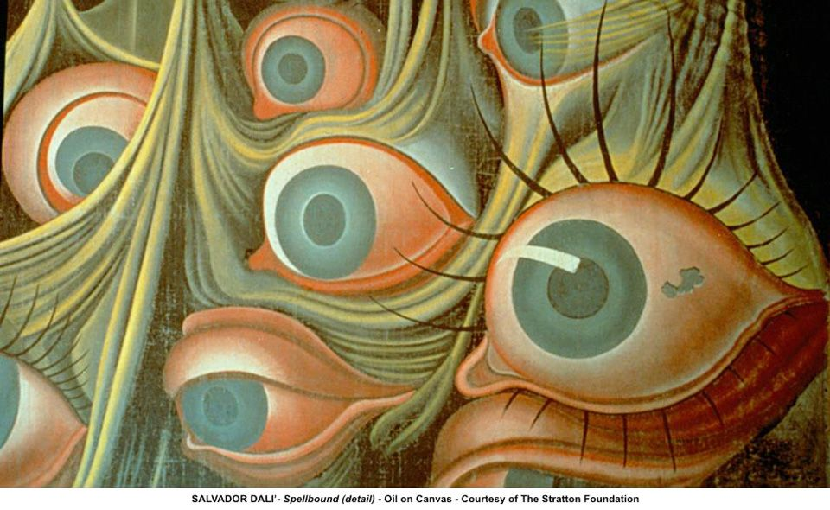
YEAR 9 HOME LEARNING; ART
We have been learning about Surrealism!
Select one of the images below by Salvador Dali and
make a copy. Ensure you develop colour.
Progression Task:
Analyse the image by: Describing:
‘In this image I can see…’
Interpreting:
‘I think the artist is trying to convey…’
Making a judgment:
‘I like the use of…’
focus on a visual element (line, tone, texture, colour, shape, pattern, space and form).
‘Persistence of time’
‘Spellbound’

