Slide 1
Power of Three
Last Year: What is a rhyming couplet?
Last Term: Which World War inspired the poem ‘Charge of the Light Brigade’?
Last Lesson: What is the language device of the ‘power of three’? Why would you use it?

Slide 2
Starter Questions
When was the play written? When was the play set?
What social class are the Birlings? What clues are there that tell you this?
What is the difference in social status between the Birlings and Gerald’s family?
What event are the family celebrating?
Issue | Birling’s Prediction | What really happened?
The Titanic
War

Slide 3
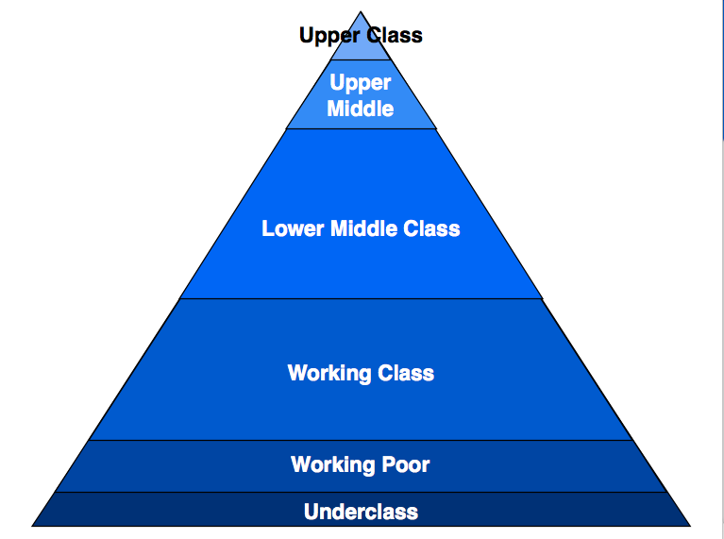
Gold: Where do the Birlings belong?
Platinum: What class are Gerald’s family?
Silver: Where would you place Edna?

Slide 4
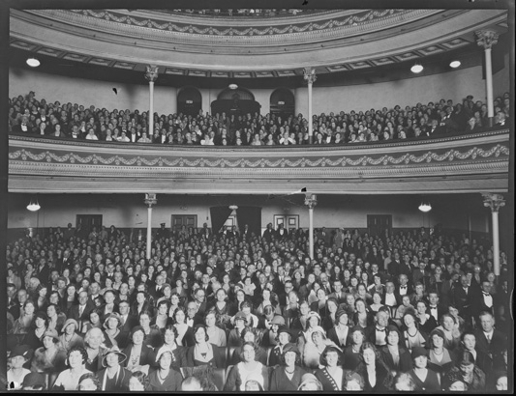
The effect on a 1945 audience
I read about the Titanic sinking and around 1500 people dying.
My son died at war.
Dramatic irony. What is the effect of this dramatic irony?
Gold: Find an example of dramatic irony which links with one of these quotes in Act 1. Explain the effect on the audience.
Silver: What themes are explored in An Inspector Calls?
Why might a 1945 audience dislike Birling from this point?
What would they think of him? Why?
What is Priestley saying?
The audience know all of these things that Mr Birling does not know. What is the name of this device?
I had no money throughout the Great Depression.
I went on strike.
I have just lived through two world wars.

Slide 5
Dramatic Irony
Dramatic irony occurs when the audience knows something the characters do not.
When Birling talks about the Titanic being unsinkable, the audience in 1945 would know that the Titanic DID sink.
What are we (the reader/audience) supposed to think about Mr. Birling?
Gold: Give 4+ reasons for your answer with evidence from the text (see next slide for help)
Silver: Give 2+ reasons for your answer with evidence from the text (see the next slide for help)
Challenge: What is a patriarchal society?

Slide 6
PEZZ response example
P – J. B. Priestley uses dramatic irony in Act 1 of ‘An Inspector Calls’.
E – An example of this is when Mr Birling says “________”.
Z –To his family, Mr Birling is a _______ character. His family think he is _______. However, through the use of dramatic irony, the audience would see Mr Birling as _______.
Zoom Out: C – Priestly wrote the play in 1945 ____________.
E - I think Priestley did this because _______.

Slide 7
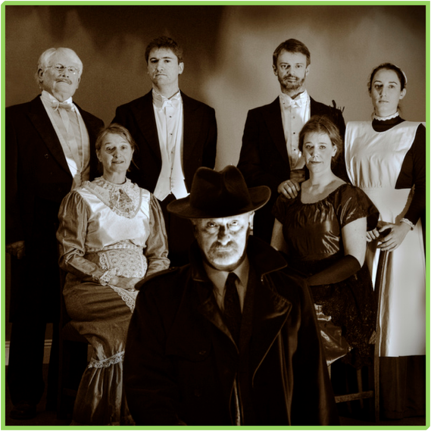
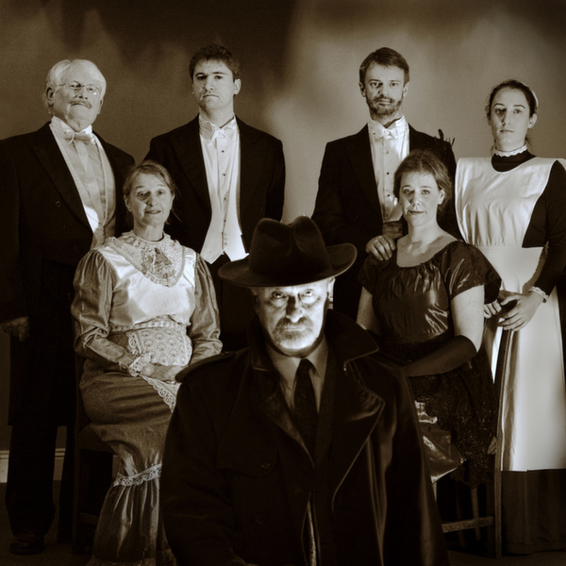
Read Act 1 and make notes on the following:
Birling
Mrs Birling
Sheila
Gerald
Eric
Edna
Inspector

Slide 8
Describing the characters...
Select one word from the table below and one of your own to describe each of the following characters:
Mr Birling, Mrs Birling, Eric, Sheila, Gerald, Inspector Goole.
Controlling | Powerful | Responsible
Pretentious | Guilty | Uneasy
Deceitful | Selfish | Irresponsible

Slide 9
To finish
Select one word from the table below and one of your own to describe each of the following characters so far:
Mr Birling, Mrs Birling, Eric, Sheila, Gerald, Inspector Goole.
Controlling | Powerful | Responsible
Pretentious | Guilty | Uneasy
Deceitful | Selfish | Irresponsible

