Slide 1
Hero of the week… Oliver Smith...!
Hero of the week… Abbie Brewer!
The Hungarian Uprising
Key Words
Tuesday, 22 September 2020
L
Rakosi
Nagy
Khrushchev
3 minutes
L/O:
P
Make a judgement on the consequences of the Hungarian Uprising
G
Game over
Analyse the action taken by Khrushchev.
S
Explain the reforms Nagy demanded.
B
Describe the events of the Hungarian Uprising.

Slide 2
Power of 3
Last lesson – What was the Arms Race?
Last week – Name one consequence of the Berlin Crisis?
Last year: Who was Joseph Goebbels?

Slide 3
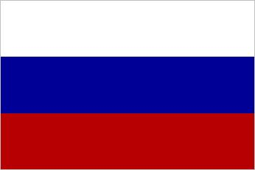
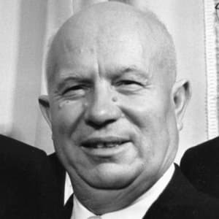
Who took over when Stalin Died?
When Stalin died in 1953, for the first time in 29 years the USSR had a new leader.
Nikita Khrushchev took over.
In 1956, Khrushchev made a speech criticising Stalin – something that no-one did for fear of death.
He spoke of de-Stalinisation.
The US thought it might signal a change in the relationship – however they were wrong. His ideas were very similar.
Task: Copy notes using the subheading who took over when Stalin died?
Nikita Khrushchev– Leader of the USSR from 1953
Notes:
3

Slide 4
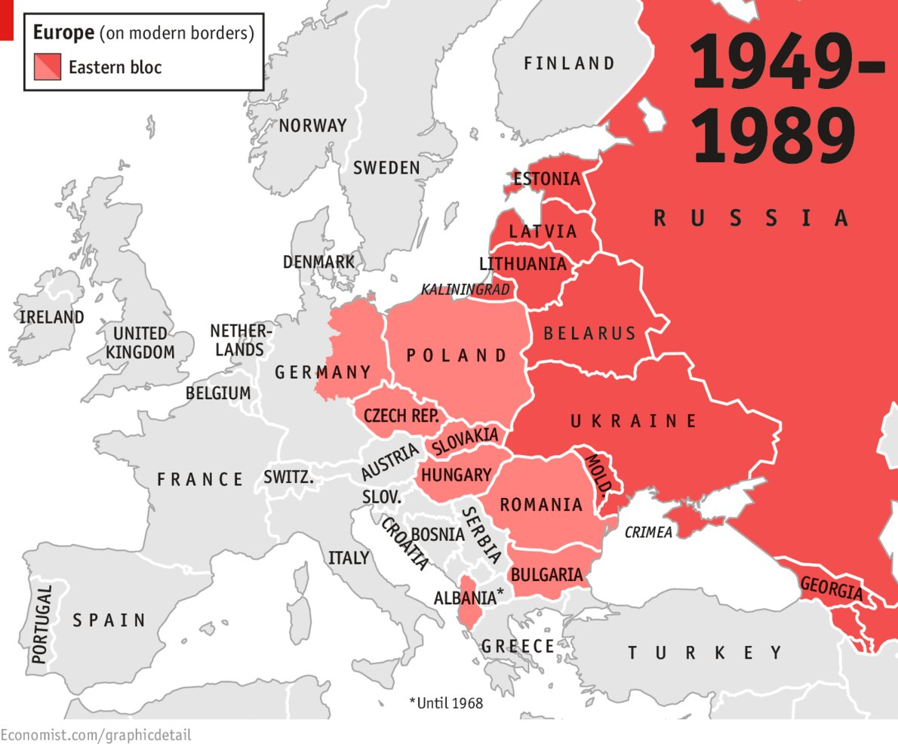
Hungary - 1956
Before 1949
Hungary had been part of the Austro-Hungarian Empire. This was something that they were very proud of.
Soviet Take-Over
1949 – Soviet Union established a Soviet Government in Hungary. They were now ruled by Communists.
Notes:
Why would Stalin want them? Buffer against Germany, gives USSR more power.
Why would USA be concerned? USSR taking power and free will from countries.

Slide 5
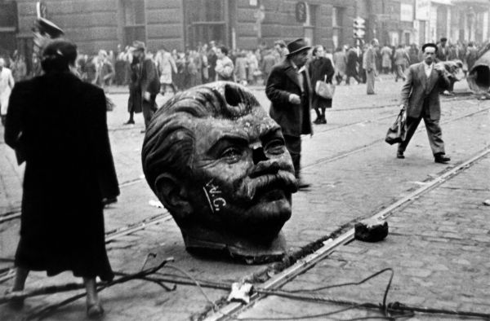
Task: Using your medal tasks answer the question to the right
Questions
What can you see?
Who might have done this and why?
What does this tell us about Hungary?

Slide 6
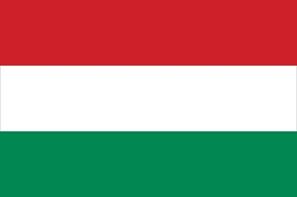
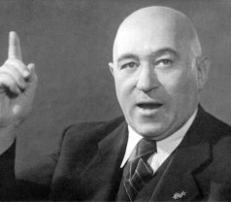
Who was in charge in Hungary?
Until 1956, Hungary was led by Matyas Rakosi.
Stalin was a big fan of Rakosi because he did exactly what he wanted.
Rakosi had a secret police he used to get rid of opponents.
Hungarian people had to pay to have Soviet troops in the country.
Street signs, shop signs and schools were all in Russian.
People in Hungary were angry due to:
Oppression
Fuel shortages
Food shortages
Matyas Rakosi – Leader of Hungary until 1956
Notes:
6

Slide 7
Task make notes on the following:
What did they do about it?
Appalled by the conditions in Hungary – the people, forced into action by OFF protested on the streets of Budapest.
They demanded free speech and the withdrawal of the Soviet troops.
Stalin’s statue was smashed and there was fierce fighting between Hungarian people and Soviet troops.
Khrushchev decided to replace Rakosi with Imre Nagy a popular communist politician, who he hoped would settle the people.

Slide 8
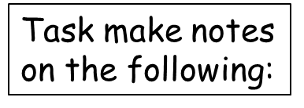
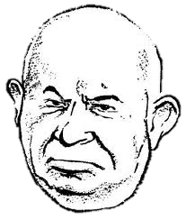
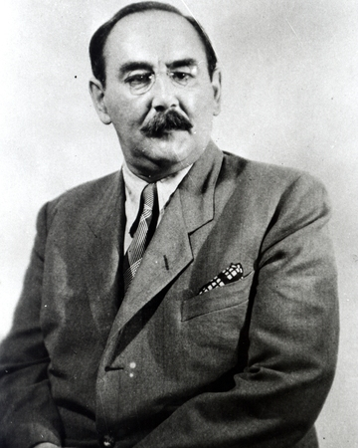
Imre Nagy
Now he’s gone too far!
Putting Nagy in charge settled things down and the Soviet troops left.
However, even though he was a communist, Nagy was keen for change.
He demanded:
Free elections
A fair legal system
Total withdrawl of Soviet troops
Private land ownership
Hungary be allowed to leave the Warsaw Pact (01 Nov 1956)
Imre Nagy – Hungarian leader from 1956.
Notes:
8

Slide 9
4th November 1956: The Soviets sent in the Red Army
Why would the USSR do this?

Slide 10
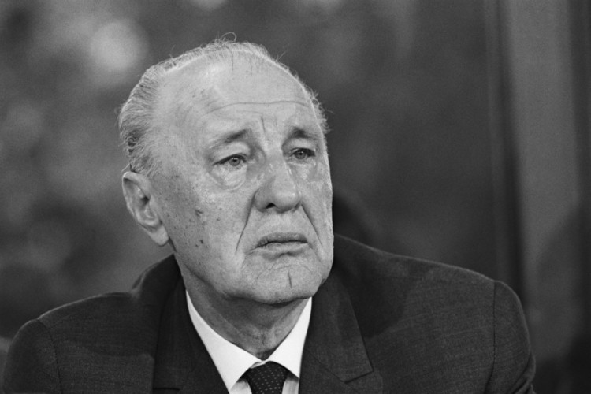
What happened next?
The Red Army, backed by 1000 tanks, rolled into Hungary and killed approximately 20,00 Hungarians to re-establish power.
Nagy and the other rebels had assumed that there would be support from the USA – it never came.
A pro-communist, pro-USSR government was set up under Janos Kadar.
Kadar promised Nagy a safe escape. He lied. Nagy was executed.
Janos Kadar – replaced and murdered Imre Nagy.
Notes:
10

Slide 11
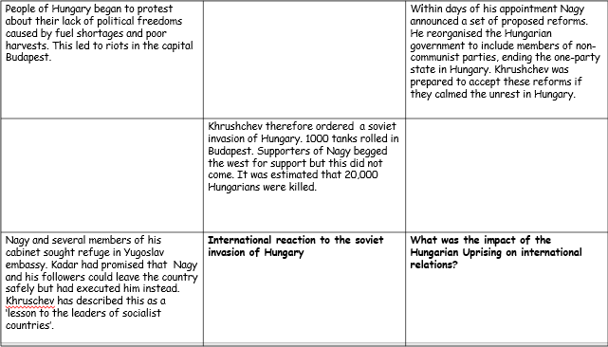
Creating your timeline
Using the completed table (slide 13) of events, finish of the timeline adding the correct events in the correct order.
10 Minutes
Challenge Task
Did Khruschev have any choice but to crush Hungary and Nagy the way he did?

Slide 12
People of Hungary began to protest about their lack of political freedoms caused by fuel shortages and poor harvests. This led to riots in the capital Budapest. |  | Within days of his appointment Nagy announced a set of proposed reforms. He reorganised the Hungarian government to include members of non-communist parties, ending the one-party state in Hungary. Khrushchev was prepared to accept these reforms if they calmed the unrest in Hungary.
 | Khrushchev therefore ordered a soviet invasion of Hungary. 1000 tanks rolled in Budapest. Supporters of Nagy begged the west for support but this did not come. It was estimated that 20,000 Hungarians were killed.
Nagy and several members of his cabinet sought refuge in Yugoslav embassy. Kadar had promised that Nagy and his followers could leave the country safely but had executed him instead. Khruschev has described this as a ‘lesson to the leaders of socialist countries’. | International reaction to the soviet invasion of Hungary | What was the impact of the Hungarian Uprising on international relations?

Slide 13
People of Hungary began to protest about their lack of political freedoms caused by fuel shortages and poor harvests. This led to riots in the capital Budapest. | Soviet troops restored order, but Khrushchev decided to replace Rakosi with Imre Nagy. He was a former prime minister who believed that within a communist regime there should still be personal freedoms. Khrushchev hoped his appointment would end the protests. | Within days of his appointment Nagy announced a set of proposed reforms. He reorganised the Hungarian government to include members of non-communist parties, ending the one-party state in Hungary. Khrushchev was prepared to accept these reforms if they calmed the unrest in Hungary.
However, on 1 Novemeber 1956 Nagy announced that Hungary would leave the Warsaw Pact, Khrushchev could not allow this as it could influence others to leave. This would threaten the security of the Soviet Union . | Khrushchev therefore ordered a soviet invasion of Hungary. 1000 tanks rolled in Budapest. Supporters of Nagy begged the west for support but this did not come. It was estimated that 20,000 Hungarians were killed. | A new pro- communist government was set up under Janos Kadar.
Nagy and several members of his cabinet sought refuge in Yugoslav embassy. Kadar had promised that Nagy and his followers could leave the country safely but had executed him instead. Khruschev has described this as a ‘lesson to the leaders of socialist countries’. | International reaction to the soviet invasion of Hungary | What was the impact of the Hungarian Uprising on international relations?

Slide 14
P
Make a judgement on why Churchill claimed there was an iron curtain.
P
Make a judgement on why Churchill claimed there was an iron curtain.
The International reaction to the Hungarian Uprising
Since the US had offer aid in the form of the Marshall Plan and wanted to contain communism people in Eastern Europe assumed that they would help in other ways.
Some NATO countries did take Hungarian refugees.
There was NO military support offered –the USA showed were they stood. They would not support any country that was already communist.
The risk of a nuclear from USA involvement war was too great

Slide 15
Explain two consequences of the Hungarian Uprising (8 marks)
Consider:
Khrushchev and the USSR looked strong and forced all other Warsaw Pact members to be obedient.
The USA looked weak. Communist countries now knew the USA would not help them.
The United Nations did nothing and looked weak.
The relationship between the USSR and USA worsened.
Writing Frame x 2
One consequence of the Hungarian Uprising was…
(1)
For example…
(1)
This meant that…
(1)
Therefore…
(1)

