Slide 1
Learning Aim: Creating a fantasy world using the conventions of fantasy
Tuesday, 22 September 2020
Last year: An example of punctuation is…
Last Term: Alliteration is…
Last Week: The name of a horror novel or film is…

Slide 2
Learning check: Fantasy Worlds

Slide 3
Pre-starter: Fantasy Worlds
Watch the following film trailers (all fantasy films) and make a list of conventions (what you would expect to find in a fantasy) of this genre.
CHALLENGE: From your list, can you come up with your own definition?
Bronze: 1-2 ideas
Silver: 3-4 ideas
Gold: 5 ideas plus an example of a fantasy novel!
EXTRA CHALLENGE: What’s the difference between fantasy and sci-fi?
https://www.youtube.com/watch?v=Q0CbN8sfihY&t=26s
https://www.youtube.com/watch?v=5O2G5uOHKn0
https://www.youtube.com/watch?v=n9DwoQ7HWvI

Slide 4
DQ: What are the conventions and types of fantasy?
Date:
Starter task:
Bronze: What do you think is meant by genre? Use the image on the right to help you.
I think genre means…
Silver: What do you think is meant by fantasy?
I think fantasy means…
Gold: Can you list any examples of books which might be considered to be fantasies?
The following books are considered fantasy…
Platinum: What is your favourite genre and why?
My favourite genre is ____ because…

Slide 5
Learning check
Write down this definition.
Fantasy: Fantasy can be seen as a psychological phenomenon. Fantasy can be seen as a form of literature
Genre: Genre is the organisation of literature into categories based on the type of writing the piece exemplifies through its content, form, or style.
The word is used to describe a particular style, which has certain characteristics or “ingredients”
Challenge: Can you think of any literary genres?
What do you think is the difference between a genre and a sub-genre? Research online and see what you can find out!

Slide 6
Learning check: Genres and Sub-genres
Texts can be separated into groups
called genres and sub-genres.
Text
Genre
Sub-genre
is a
Fruit
Banana
is a
Food
Harry Potter
Book
is
Fiction
is
Fantasy

Slide 7
Learning check: Fiction Sub-genres
Fiction
Realistic
Fiction
Fantasy
Science
Fiction
Historical
Fiction

Slide 8
https://www.youtube.com/watch?v=n_cqszvdTqk
Watch the video and respond to the questions below:
Bronze: What is genre? Add to your definition. Genre is…
Silver: What types of genres might there be for music and fiction? Some different types of genre for music and fiction are…
Gold: What makes fantasy different from other types of fiction? Fantasy is different from other types of fiction because…
Platinum: What might you find in a fantasy fiction? You might find the following in fantasy fiction…
Stretch & Challenge: What is modern or contemporary fantasy? Modern/contemporary fantasy is…
Super challenge: How might fantasy relate to our own lives? Fantasy might relate to our lives in the following ways…

Slide 9
Learning check: Fantasy
Form of fiction (not true)
Contains one or more of the following:
supernatural occurrences
characters with magical powers
things with magical powers
animals with human characteristics
real people in fantastic places
fantastic creatures or characters in real situations

Slide 10
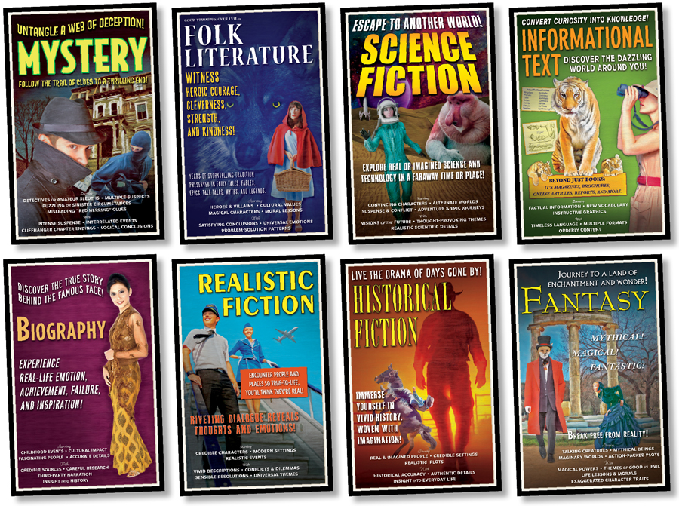
Investigation…
Read the following extract.
What do you notice about:
Bronze: Description
Silver: Character(s)
Gold: Setting
Platinum: Dialogue
S&C: Language (words)
Decide which genre (or genres) the story belongs to. How do you know?

Slide 11
1.
October arrived, spreading a damp chill over the grounds and into the castle. Madam Pomfrey, the nurse, was kept busy by a sudden spate of colds among the staff and students. Her Pepperup potion worked instantly, though it left the drinker smoking at the ears for several hours afterward. Ginny Weasley, who had been looking pale, was bullied into taking some by Percy. The steam pouring from under her vivid hair gave the impression that her whole head was on fire. Raindrops the size of bullets thundered on the castle windows for days on end; the lake rose, the flower beds turned into muddy streams, and Hagrid's pumpkins swelled to the size of garden sheds. Oliver Wood's enthusiasm for regular training sessions, however, was not dampened, which was why Harry was to be found, late one stormy Saturday afternoon a few days before Halloween, returning to Gryffindor Tower, drenched to the skin and splattered with mud. Even aside from the rain and wind it hadn't been a happy practice session. Fred and George, who had been spying on the Slytherin team, had seen for themselves the speed of those new Nimbus Two Thousand and Ones. They reported that the Slytherin team was no more than seven greenish blurs, shooting through the air like missiles.

Slide 12
Challenge
Complete a checklist of what you think are the common features of fantasies.
Consider:
B: Names
S: Character descriptions
G: Setting and places
P: Supernatural
Stretch and challenge: Create a list of what you think are the different types of fantasies.

Slide 13
Learning check: Common features
Magic/mysticism
Monsters
Non-human characters
Often taken from Nordic mythology
Human heroes
Knights, kings, common men pressed into service
Stereotypic character roles
Hero, helper, princess, witch, evil knight, etc.
Quests
The Holy Grail, the Golden Fleece, Destruction of the Ring, Recovery of the Lost Ark, The getting of wisdom, Destruction of the Minotaur
Cataclysmic confrontation between good and evil
Battle for Middle Earth, War for Narnia, etc.

Slide 14
Learning check: 5 kinds of Fantasy
Fantasy Animal Stories – animals have human characteristics – Charlotte’s Web, Babe the Gallant Pig, Clifford books
Ghost stories or supernatural fiction – has characters from the spirit world – Wait Till Helen Comes
Time fantasy and space fiction – Travel back and forth in time – Missing Series
Science Fiction – based on scientific fact – contains elements within the realm of possibility because of scientific discoveries – The Giver, A Wrinkle in Time
High Fantasy – epic in nature, usually include a quest – Narnia series, Harry Potter, Star Wars, Roald Dahl books

Slide 15
Fantasy Worlds
You are going to be inventing your own fantastical world. Using the table below as a guide, write down what the rules are of our world, and then write down what the rules of your world are going to be.
 | The real world | My fantasy world
Location/map | Earth – land, sea, houses, shops
Concrete rules | Gravity, school/education, money
People
People
Magic
Religion
Politics
Society

Slide 16
Planning time
We are going to finish the lesson by making our own fantasy storyline. Use your rules sheet to help you.
Remember to include:
Magic/mysticism
Monsters
Non-human characters
Human heroes
Quests
Cataclysmic confrontation between good and evil

Slide 17
Fantasy Worlds
Medal Task
TASK: Spend twenty minutes writing the opening to your fantasy world.
 | Bronze | Silver | Gold
Generic Conventions | Somewhat clear awareness of typical generic conventions. | A clear awareness of generic conventions. | A clear awareness of generic conventions with an increasing sense of attention to detail.
Creative and imaginative work | Typical/common ideas used in relation to genre. | Clear attempts to instill a sense of imagination and creativity, making writing somewhat engaging. | Imagination and creativity is evident and makes writing engaging.
Paragraphs | Accurate use of paragraphs for time, topic, place and speech. | Accurate use of paragraphs for time, topic, place and speech and varied length. | Accurate use of paragraphs for time, topic, place and speech with varied lengths to create specific effects.
Vocabulary | Some successful attempts to select vocabulary and language devices. | Thoughtful selection of vocabulary and language devices, making writing somewhat engaging. | Ambitious and thoughtful use of vocabulary and language devices to make writing engaging throughout.
Sentences | Mostly accurate use of sentences and demarcation. | Accurate use of sentences and demarcation. | Accurate use of sentences and demarcation to create =effects.
SPAG | Basic words, punctuation and grammar is accurate. Some more complex SPAG is inaccurate. | A range of punctuation, grammar and some ambitious words are accurate. | A wide range of punctuation, grammar and some ambitious words are accurate and used for effect.

