Slide 1

Animals and Plant Cells
L.O: Recall animal and plant cell key components
Curiosity: Define plant and animal cells
Motivation: to complete all the work.
Resilience: to keep trying.
1: What is the biggest hazard in a science lab and why?
2: Define resolution
3: What is the chemical symbol for gold?

Slide 2
Animals and Plant Cells
L.O: Recall animal and plant cell key components
Curiosity: Define plant and animal cells
Motivation: to complete all the work.
Resilience: to keep trying.
A cell is the very smallest unit of living matter.
All living things (called organisms), including plants and animals, are made up of cells.

Slide 3
Animals and Plant Cells
L.O: Recall animal and plant cell key components
Curiosity: Define plant and animal cells
Motivation: to complete all the work.
Resilience: to keep trying.
https://www.youtube.com/watch?v=8IlzKri08kk
Watch the video, start from 45 seconds

Slide 4
Animals and Plant Cells
L.O: Recall animal and plant cell key components
Curiosity: Define plant and animal cells
Motivation: to complete all the work.
Resilience: to keep trying.
Draw and label the following two cells, add the descriptions for each organelle (each of the parts of the cells).

Slide 5
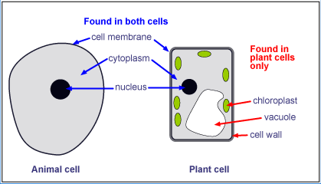
Animals and Plant Cells
L.O: Recall animal and plant cell key components
Curiosity: Define plant and animal cells
Motivation: to complete all the work.
Resilience: to keep trying.
The cell membrane surrounds the cell and holds the cell together. It also controls what chemicals can enter and leave the cell.

Slide 6
Animals and Plant Cells
L.O: Recall animal and plant cell key components
Curiosity: Define plant and animal cells
Motivation: to complete all the work.
Resilience: to keep trying.
The cytoplasm is a jelly-like mixture of chemicals where most of the chemical reactions of the cell takes place

Slide 7
Animals and Plant Cells
L.O: Recall animal and plant cell key components
Curiosity: Define plant and animal cells
Motivation: to complete all the work.
Resilience: to keep trying.
The nucleus controls the cell. Inside the nucleus is DNA which contains genetic information.

Slide 8
Animals and Plant Cells
L.O: Recall animal and plant cell key components
Curiosity: Define plant and animal cells
Motivation: to complete all the work.
Resilience: to keep trying.
Chloroplasts are disc shaped and contain chlorophyll (green pigment) for photosynthesis (how plants make energy)

Slide 9
Animals and Plant Cells
L.O: Recall animal and plant cell key components
Curiosity: Define plant and animal cells
Motivation: to complete all the work.
Resilience: to keep trying.
A vacuole where the plant cell stores sap (the food that it has made; a mixture of sugars, salts and water).

Slide 10
Animals and Plant Cells
L.O: Recall animal and plant cell key components
Curiosity: Define plant and animal cells
Motivation: to complete all the work.
Resilience: to keep trying.
A cell wall which is a strong outer layer to support the cell and give it shape.

Slide 11
Animals and Plant Cells
L.O: Recall animal and plant cell key components
Curiosity: Define plant and animal cells
Motivation: to complete all the work.
Resilience: to keep trying.
Organism
Organ system
Organ
Tissue
Cell
Organelle
Largest
All living things follow a strict organisation system. A group of each level makes the (larger) one above. We call this hierarchical organisation
Smallest

Slide 12
Animals and Plant Cells
L.O: Recall animal and plant cell key components
Curiosity: Define plant and animal cells
Motivation: to complete all the work.
Resilience: to keep trying.
Imagine you’re looking at this down a microscope: How would you draw a cell?

Slide 13
Animals and Plant Cells
L.O: Recall animal and plant cell key components
Curiosity: Define plant and animal cells
Motivation: to complete all the work.
Resilience: to keep trying.
Appropriate size
Smooth lines
No shading
What did I do wrong?

Slide 14
Animals and Plant Cells
L.O: Recall animal and plant cell key components
Curiosity: Define plant and animal cells
Motivation: to complete all the work.
Resilience: to keep trying.
Without looking at the diagrams from earlier, draw a plant and animal cell in your books with their organelles. Add labels
Marks out of 11!

Slide 15
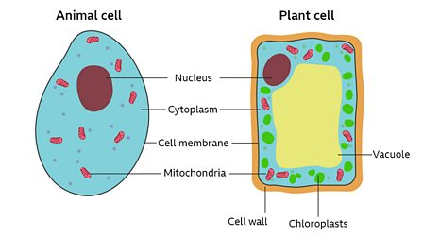
Animals and Plant Cells
L.O: Recall animal and plant cell key components
Curiosity: Define plant and animal cells
Motivation: to complete all the work.
Resilience: to keep trying.
Without looking at the diagrams from earlier, draw a plant and animal cell in your books with their organelles. Add labels
Marks out of 11!
Check your work
Correct shapes (2)
Correct name of cell (2)
Correct labels to the right organelles (7)
Marks out of 11!

Slide 16
Animals and Plant Cells
L.O: Recall animal and plant cell key components
Curiosity: Define plant and animal cells
Motivation: to complete all the work.
Resilience: to keep trying.
Complete the table below;
Bronze, complete the function column
Silver, complete the function and description column
Gold, complete the whole table
Use the internet to help you and check your answers on the next slide.
Organelle Name | Function | Description | Diagram
Cell membrane
Nucleus
Mitochondria
Ribosome
Cell wall
Chloroplast
Vacuole

Slide 17
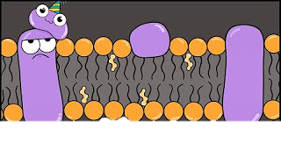
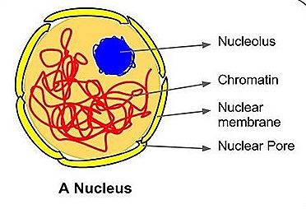
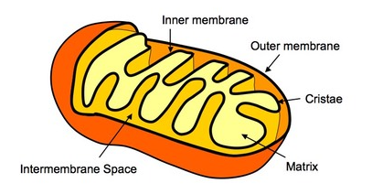
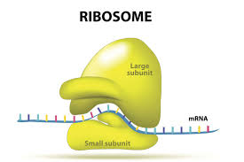
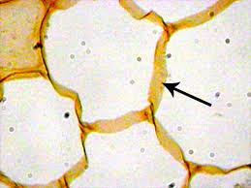
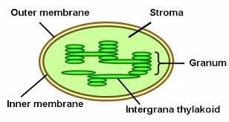
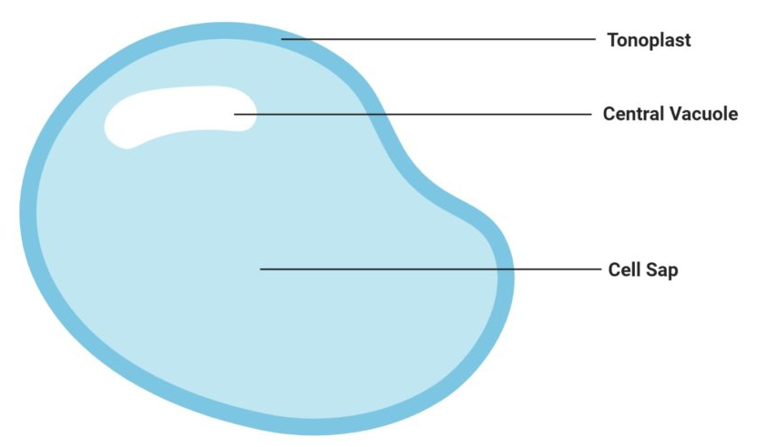
Organelle Name | Function | Description | Diagram
Cell membrane | Protects inside of the cell from the outside and selectively allows nutrients through. | Phospholipid bi-layer (two layers)
Nucleus | Controls the cells growth and division. Stores the DNA | Enclosed in a membrane, contains the cells DNA and proteins to form chromosomes
Mitochondria | Generates energy in the form of ATP for respiration | A double membraned organelle
Ribosome | Makes proteins | Small particles in the cytoplasm which ‘reads’ DNA to make proteins
Cell wall | It provides the cell with both structural support and protection, and also acts as a filtering mechanism | Tough, flexible, and sometimes rigid, just outside the cell membrane
Chloroplast | Location of photosynthesis in plants and algae | Filled with chlorophyll which gives plants their green pigmentation
Vacuole | Storage ‘bubbles’, used to help give plant cells their turgid shape | A bubble like structure, found in plant cells.

