Slide 1

Microscopes and Magnification
L.O: Identify and recall the parts of a microscope and how to use them
Curiosity: How have microscopes changed?
Motivation: to complete all the work.
Resilience: to keep trying.
Draw and label a simple plant and animal cell (use pencil for the drawings)
2. Explain why some cell structures can't be seen with a light microscope.
3. What is the calculation for total magnification?

Slide 2
Microscopes and Magnification
L.O: Identify and recall the parts of a microscope and how to use them
Curiosity: How have microscopes changed?
Motivation: to complete all the work.
Resilience: to keep trying.
https://www.youtube.com/watch?v=tVcEEw6qbBQ
Watch this video; start from 40seconds.

Slide 3
Microscopes and Magnification
L.O: Identify and recall the parts of a microscope and how to use them
Curiosity: How have microscopes changed?
Motivation: to complete all the work.
Resilience: to keep trying.
Answer these questions:
What is the difference between a light microscope and an electron microscope?
Define resolution.

Slide 4
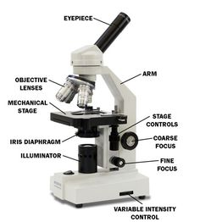
Microscopes and Magnification
L.O: Identify and recall the parts of a microscope and how to use them
Curiosity: How have microscopes changed?
Motivation: to complete all the work.
Resilience: to keep trying.

Slide 5
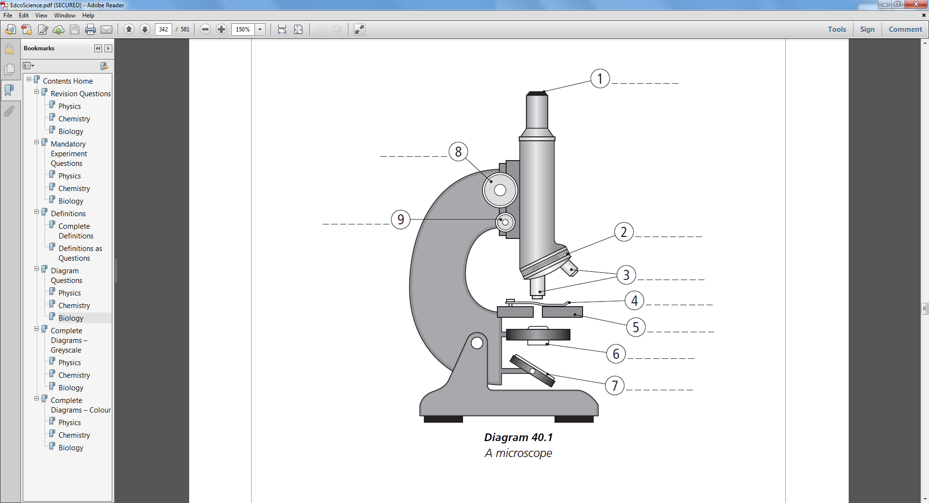
Microscopes and Magnification
L.O: What is the learning objective?
Curiosity: How have microscopes changed?
Motivation: to complete all the work.
Resilience: to keep trying.
Label the diagram

Slide 6
Microscopes and Magnification
L.O: What is the learning objective?
Curiosity: How have microscopes changed?
Motivation: to complete all the work.
Resilience: to keep trying.
Part | Match the parts and functions | Function
Eyepiece Lens |  | Controls the amount of light that goes onto the microscope slide.
Objective Lens |  | This is the lens closest to your eye. It usually has a magnification of x10
Stage |  | This is used to focus the image so it is very sharp and clear.
Diaphragm |  | This is used to focus the image so that you can see it clearly.
Light |  | This holds the eyepiece lens above the stage.
Base |  | There are three lenses of different strengths which can be used to magnify the image more clearly.
Arm |  | This is the place where you put a microscope slide. Clips hold the slide in place
Fine Focus Knob |  | The light source projects light onto the microscope slide. It can be a mirror or an electric bulb.
Coarse Focus Knob |  | This is very heavy to keep the microscope from falling over

Slide 7
Microscopes and Magnification
L.O: Identify and recall the parts of a microscope and how to use them
Curiosity: How have microscopes changed?
Motivation: to complete all the work.
Resilience: to keep trying.
Number the sentences into the correct order.
______ Look into the eyepiece lens. | ______ Place the slide on the stage.
______ Place the smallest objective lens over the hole in the stage. | ______ Turn the coarse focusing wheel until what you see is clear.
______ Turn the coarse focusing wheel until the objective lens and the stage are as close as possible. | ______ Adjust the light source.

Slide 8
Microscopes and Magnification
L.O: Identify and recall the parts of a microscope and how to use them
Curiosity: How have microscopes changed?
Motivation: to complete all the work.
Resilience: to keep trying.
Calculating sizes using magnifications (copy these two down):
Total magnification = eyepiece lens x objective lens
Magnification= Image size ÷ actual size
I
A
M

Slide 9
Microscopes and Magnification
L.O: Identify and recall the parts of a microscope and how to use them
Curiosity: How have microscopes changed?
Motivation: to complete all the work.
Resilience: to keep trying.
How to draw a cell: (copy the diagram on the right)
Appropriate size
Smooth lines
No shading

Slide 10
Microscopes and Magnification
L.O: Identify and recall the parts of a microscope and how to use them
Curiosity: How have microscopes changed?
Motivation: to complete all the work.
Resilience: to keep trying.
Bronze: Suggest why in schools light microscopes are used in favor of an electron microscope
Silver: Discuss why it is important to follow a procedure when making slides.
Gold: Explain why it is important to draw cells in a specific format and why it is important that we calculate their magnification.

