Slide 1
Learning Aim: Introduction to Poetry
Thursday, 17 September 2020
TITLE: Y8 Introduction to Poetry
Last year: Give an example of exaggeration?
Last Term: Why do you think the stable buck had to sleep in a separate bunk to the other workers?
Last Lesson: Who was to blame for WW1 do you think?

Slide 2
Keywords: What do you think the following words mean?
Confrontation:
Disinfected:
Tender:
Defiant:
Trailing:
Conflict:

Slide 3
Keywords:
Confrontation: a disagreement with another
Disinfected: to remove all germs and living microorganisms
Tender: sensitive and delicate
Defiant: to challenge or refuse
Trailing: to follow behind
Conflict: a disagreement, often violent

Slide 4
Poetry Terms Link the Poetry term with its definition
Poetical Term
Alliteration
Couplet
Pathos
Personification
Enjambment
Caesura
a continuation of a sentence without pause at the end of lines
The same sound/letter at the beginning of close words
a break in the middle of a line using punctuation
part of a poem that makes the reader feel sad
a pair of lines often the same length that rhyme
something non-human given human qualities

Slide 5
Poetry Terms Check your answers
Poetical Term | Definition
Alliteration | The same sound/letter at the beginning of close words
Couplet | a pair of lines often the same length that rhyme
Pathos | part of a poem that makes the reader feel sad
Personification | something non-human given human qualities
Enjambment | a continuation of a sentence without pause at the end of lines
Caesura | a break in the middle of a line using punctuation

Slide 6
Catrin
I can remember you, child, As I stood in a hot, white Room at the window watching The people and cars taking Turn at the traffic lights. I can remember you, our first Fierce confrontation, the tight Red rope of love which we both Fought over. It was a square Environmental blank, disinfected Of paintings or toys. I wrote All over the walls with my Words, coloured the clean squares With the wild, tender circles Of our struggle to become Separate. We want, we shouted, To be two, to be ourselves.
Neither won nor lost the struggle In the glass tank clouded with feelings Which changed us both. Still I am fighting You off, as you stand there With your straight, strong, long Brown hair and your rosy, Defiant glare, bringing up From the heart’s pool that old rope, Tightening about my life, Trailing love and conflict, As you ask may you skate In the dark, for one more hour.

Slide 7
First Reading of Catrin Task: 10 minutes
After reading 'Catrin' for the first time, what do you think the poem is about?
Bronze: Your response is clear, with a reference to the poem.
Silver: Your response is thoughtful, making two references from the poem.
Gold: Your response is thoughtful, making two or more references from the poem, identifying poetical devices.

Slide 8
Annotating the poem
Annotating something means to label it with notes.
Circle the following in the poem and write what it is and what it means:
Keywords (words that are difficult to understand or are important)
An example of enjambment
Lists
Metaphors
Personification

Slide 9
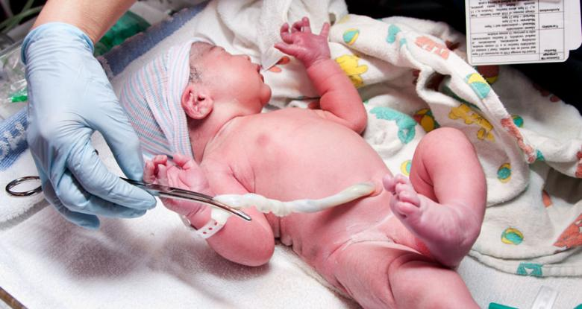
Read the poem for a second time, considering these images...

Slide 10
Second Reading: Alternative Meanings
After reading 'Catrin' for a second time, what do you think the poem is about?
Bronze: Your response is clear, with a reference to the poem.
Silver: Your response is thoughtful, making two references from the poem.
Gold: Your response is thoughtful, making two or more references from the poem, identifying poetical devices.

Slide 11
Plenary
Read aloud your response. Check that you have achieved your medal task.
Is your response...
Bronze: clear, with a reference to the poem.
Silver: thoughtful, making two references from the poem.
Gold: thoughtful, making two or more references from the poem, identifying poetical devices.

