Slide 1
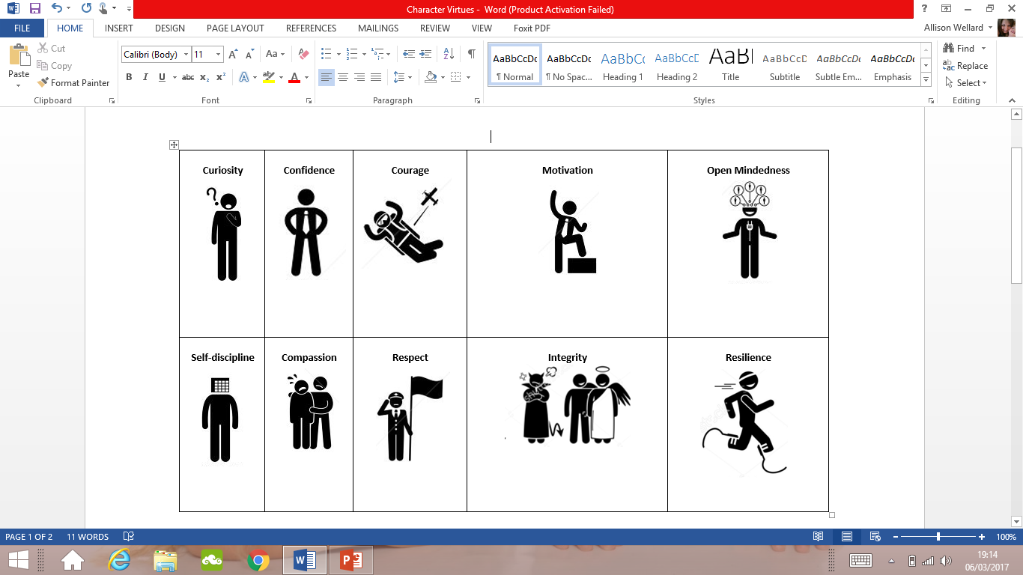

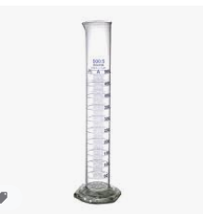
Tuesday, 22 September 2020
Lock down work Yr8.
LO – Use the slides to improve your knowledge for the up coming assessment.
Earn a reward point for Confidence for attempting a challenging activity.
Last Lesson: Name the only state of matter that can be compressed?
Liquid
Solid
Gas
Last Term: This item of scientific equipment is called ?
Measuring cylinder
Last Year: Jane needs to weigh some calcium carbonate powder for an experiment, which piece of equipment should she use?
Balance
Measuring cylinder
Scales
Notes:
5 mins

Slide 2
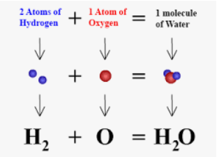
Key words
Atom: The smallest part of an element that can still be recognised as that element.
Element: A substance made up of only one type of atom. An element cannot be broken down chemically into any simpler substance.
https://www.bbc.co.uk/bitesize/guides/z463rwx/revision/2
Use the link BBC bitesize, this site is useful by breaking down the information into small chunks.
Molecules: Two to thousands of atoms joined together by chemical bonds. Most non-metals exist either as small or giant molecules.
Compound: Pure substances made up of two or more elements strongly joined together.
Chemical formula: Shows the elements present in a compound
And their relative proportions.
Polymer: A molecule made of thousands of smaller molecules
In a repeating pattern. Plastics are man-made polymers, starch is a natural polymer.

Slide 3
Elements
An element is a substance that contains only one type of atom.
Quite a lot of everyday substances are elements
Over 100 different elements
Each Element has a symbol – one or two letters
Oxygen – O
Carbon – C
Helium – He
Iron – Fe

Slide 4
Compound
Is when two or more atoms join together, a molecule is made. The join is known as a chemical bond
Compounds are formed when atoms from different elements join together
Example: Carbon Dioxide – CO2 and Water H2O

Slide 5
Mixtures
A pure substance is made up of only one type of element OR only one type of compound. It can’t be separated into anything simpler without a chemical reaction.
A Mixture contains two or more different substances. These substances aren’t chemically joined up .

Slide 6

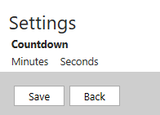
Tuesday, 22 September 2020
LO: Identifying oxidation & displacement reactions.
Earn a reward point for Confidence for attempting a challenging activity.
Last Lesson: What is the best definition of a compound?
A substance made up of two or more elements that are chemically combined
A substance made up of two or more elements that are chemically combined in fixed proportions
A substance made up of two elements that are chemically combined in fixed proportions.
Last Term: How many different types of atom are in one molecule of a substance that has the formula N O ?.
(i) 6 (ii) 4 (iii) 2
2
4
Last Year: What is the formula for water?
H O
2
Notes:
5 mins

Slide 7
Key words
Displacement: Reaction where a more reactive metal takes place the place of a less reactive metal in a compound.
(you need to remember the reactivity series) see next slide.
Oxidation: Reaction in which a substance combines with Oxygen.
Reactivity: The tendency of a substance to undergo a chemical reaction.

Slide 8
Earn a reward point for Confidence for attempting a challenging activity.
Where are the metals found?
What are they combined with?
How are they removed?
Reactivity Series
Potassium
Sodium
Calcium
Magnesium
Aluminium
Zinc
Iron
Tin
Lead
Copper
Silver
Gold
Platinum
Carbon (non-metal)
Hydrogen (non-metal)

Slide 9
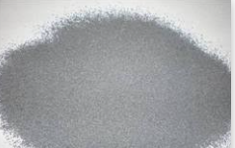
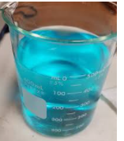
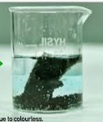
Displacement
Magnesium
Mg (s)
Copper Sulfate
Cu SO(aq)
4
Magnesium sulfate + Copper
Mg (s) + Cu So MgSO (aq) + Cu (s)
4
4

Slide 10
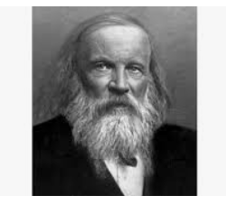
All the different elements are arranged in a chart called the periodic table. A Russian scientist called Dmitri Mendeleev produced one of the first practical periodic tables in the 19th century. The modern periodic table is based closely on the ideas he used:
Dmitri Mendeleev
Dmitri Mendeleev was a Russian chemist. He wrote chemistry books and was looking for ways to organise the known elements. He published his first periodic table of the elements in 1869. In it, he arranged the elements in order of increasing atomic weights. He also took into account the properties of the elements and their compounds. This meant that his table:
had gaps in it
showed elements with similar chemical properties lined up in groups
However, from their atomic weights, some pairs of elements next to each other were in the wrong order.
Predictions using gaps
Mendeleev left gaps in his table for elements not known at the time. By looking at the properties of the elements next to a gap, he could also predict the properties of these undiscovered elements. For example, Mendeleev predicted the existence of 'eka-silicon', which would fit into a gap below silicon. Another scientist later discovered the missing element, germanium. Its properties were found to be similar to the predicted ones and confirmed Mendeleev's periodic table.
https://www.youtube.com/watch?v=-wu0LixSBpk

Slide 11
Have a go at these questions
Q1, Which substance is oxidised in the reaction represented by this equation?
Lead oxide + carbon → lead + carbon dioxide
(i) Lead oxide
(ii) Carbon
(iii) Lead
Q2, Which of these equations represents a displacement reaction
Copper + oxygen copper oxide
Zinc + copper sulfate zinc sulfate + copper
Sodium + water sodium hydroxide + water
Q3, Which element removes oxygen from iron(III) oxide in the industrial extraction of iron?
Copper
Calcium
Carbon
Create a method to remember these 3 key words.
Displacement: Reaction where a more reactive metal takes place the place of a less reactive metal in a compound.
Oxidation: Reaction in which a substance combines with Oxygen.
Reactivity: The tendency of a substance to undergo a chemical reaction.

Slide 12
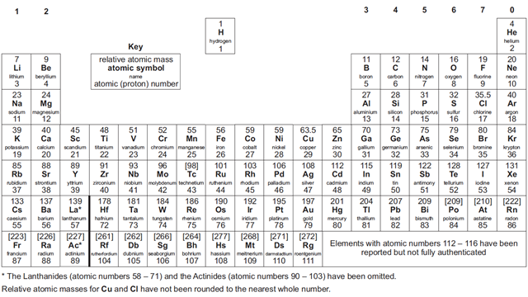
Group 7, The halogens. Its members are nasty lot in pure form. They are highly reactive, violently smelly substances.
Chlorine used in WW1.
Although in compounds such as
Fluoridated toothpaste they are tamed for domestic use.
Alkaline earth metals
The Halogens
Periods are horizontal (1)
2
3
Group 8 or zero as it is some times labelled) contains noble gases. More reactive as you go up.
Alkali metals. Group 1 react with water to form hydrogen, more reactive as you go down.
Transition metals

Slide 13
Q1 How are the elements arrange in the periodic table?
Q2 What are the horizontal rows called ?
Q3 What are the vertical row called?
Q4, I'm in group 5 at the very top of the periodic table, what element am I
Q5, Am I a metal or gas (links to Q4)
Q6, Name me period 4, group 3 where the points join.
Q7, Name me period 2 , group 6 where the points meet
Increasing Atomic number
Periods
Groups
Nitrogen
Gas
Gallium
Oxygen

Slide 14

Earn a reward point for Confidence for attempting a challenging activity.
All: Answer exam question handout.
Peer Assess. WWW, What went well, EBI, Even better if
Bronze 1: How are the elements arrange in the periodic table?
Bz 2: What are the horizontal rows called ?
Silver: Using a periodic table, state how many electrons boron has in its outer shell
Silver 2: Briefly describe how Mendeleev arranged the elements in his version of the periodic table.
Gold: Mendeleev left gaps in his periodic table. He used the properties of the other elements in the columns with gaps to predict the properties of these undiscovered elements.
Explain how this later helped to confirm that his ideas were correct.

Slide 15
Earn a reward point for Confidence for attempting a challenging activity.
All: Answer exam question handout.
Peer Assess. WWW, What went well, EBI, Even better if
Bronze 1: How are the elements arrange in the periodic table?
Increasing Atomic number
Bz 2: What are the horizontal rows called ?
Periods
Silver: Using a periodic table, state how many electrons boron has in its outer shell
(3)
Silver 2: Briefly describe how Mendeleev arranged the elements in his version of the periodic table.
Mendeleev sorted the elements into groups , based on their properties. He realised that if he put the elements in order of atomic mass, he could put elements with similar chemical properties into the same columns.
Gold: Mendeleev left gaps in his periodic table. He used the properties of the other elements in the columns with gaps to predict the properties of these undiscovered elements.
Explain how this later helped to confirm that his ideas were correct.
When the elements were discovered that fitted the gaps Mendeleev had left, their properties matched the properties that he had predicted.

Slide 16
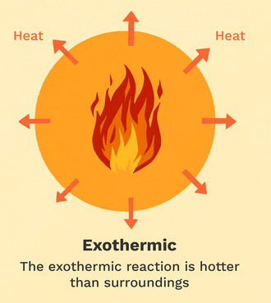
Key words
Catalysts: Substances that speed up chemical reactions but are unchanged at the end.
Exothermic reaction: One in which energy is giving out, usually as het or light.
Endothermic reaction: One in which energy is taken in, usually as heat.
Chemical Bond: Force that holds atoms together in molecules.
An Exothermic reaction is one which transfers energy to the surroundings
Energy is usually given out by heating.
So Exothermic reactions involve an increase in temperature
The best example of exothermic reactions is combustion (This gives out a lot of energy - its very exothermic.
Many neutralisation reactions and oxidation reactions are exothermic.
Everyday uses of exothermic reactions include hand warmers and self-heating cans of coffee.

Slide 17
Neutralisation
So,
Sulfuric acid + calcium oxide → ? + ?
Acid + metal oxide → salt + water
Sulfuric acid + calcium oxide → calcium sulfate + water

Slide 18
Point to the correct salt
Sulfuric acid + copper oxide → ……………… + water
Hydrochloric acid + magnesium oxide → …… + water
Nitric acid + copper carbonate → …………… + water + carbon dioxide.
Sulfuric acid + magnesium hydroxide →
Salt
Salt
Salt
Magnesium
Sulfate + hydrogen

Slide 19
Neutralisation answers
Acid + metal oxide → salt + water
Acid + metal hydroxide → salt + water
Acid + metal carbonate → salt + water + carbon dioxide
Sulfuric acid = sulfate
Nitric acid = nitrate
Hydrochloric acid = chloride

Slide 20
Sulfuric acid
Sulfuric acid + Calcium oxide → calcium sulfate + water
Sulfuric acid + Calcium hydroxide → calcium sulfate + water
Sulfuric acid + Calcium carbonate → calcium sulfate + water + carbon dioixde

Slide 21
Hydrochloric acid
Hydrochloric acid + Copper oxide → copper chloride + water
Hydrochloric acid + Copper hydroxide → copper chloride + water
Hydrochloric acid + Copper carbonate → copper chloride + water + carbon dioixde

Slide 22
Nitric acid
Nitric acid + Sodium oxide → sodium nitrate + water
Nitric acid + Sodium hydroxide → sodium nitrate + water
Nitric acid + Sodium carbonate → sodium nitrate + water + carbon dioixde

Slide 23
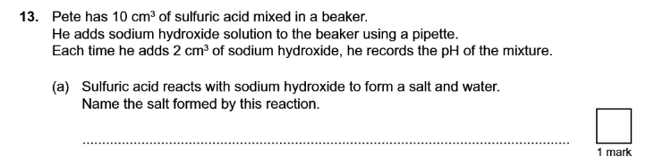
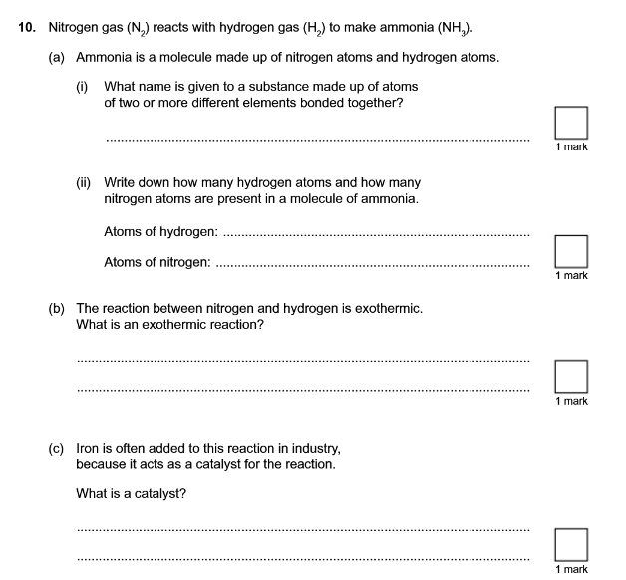
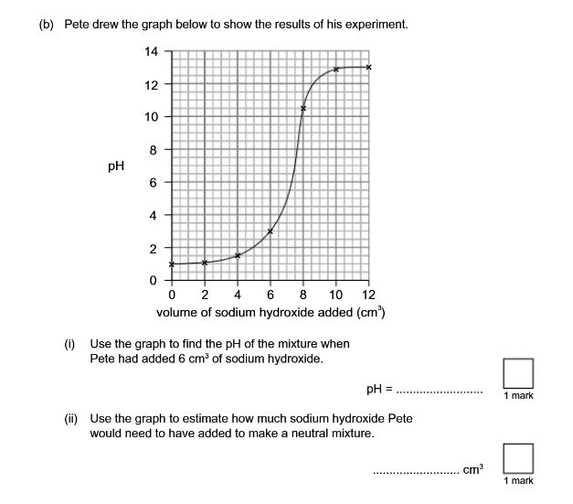
Examples of exam questions.

Slide 24
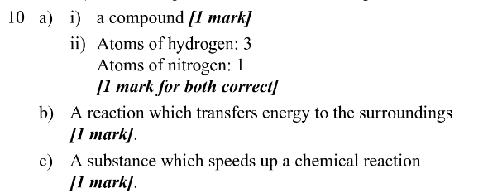
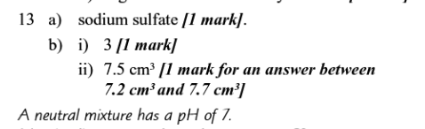
Answers

