Slide 1
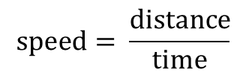
States of Matter
L/O – compare the energy of the different states of matter
Last week: Complete the Punnett square below and calculate the probability of a child having the recessive trait
 | T | t
t
t
Last term: Describe the role of the chloroplasts, cell wall and vacuole in a plant cell
Key Words
Melting
Freezing
Evaporation
Condensation
Sublimation
Deposition
Last Year: Change the subject of this equation to time
$$speed= \frac{distance}{time}$$

Slide 2

First Attempt In Learning– Draw the particles in a solid, liquid and gas from memory

Slide 3
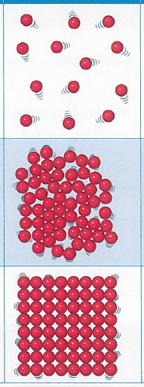
First Attempt In Learning– Draw the particles in a solid, liquid and gas from memory
SAIL – Correct your diagrams and explain why only a solid holds a fixed shape
Extension – Explain why only a gas can be compressed

Slide 4
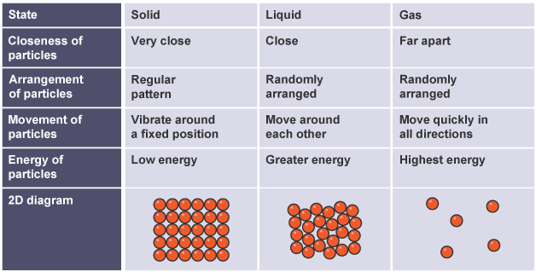
Watch this video summarising the properties of the 3 states of matter
https://www.youtube.com/watch?v=JY6f_r4dHpg

Slide 5
Everyone: label the diagram using the key words
Condensation
Deposition
Evaporation
Freezing
Melting
Sublimation
Bronze: Explain how you can cause these changes
Silver: Explain which state of matter has the highest energy and which has the lowest
Gold: Explain how a change in energy can cause a gas to turn back into a liquid
SOLID
LIQUID
GAS

Slide 6
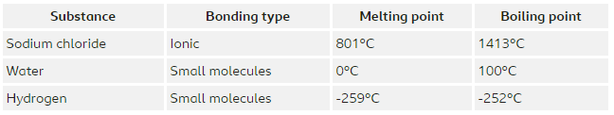
The amount of energy it takes to change the state of a substance depends on how strong the forces are between the molecules.
The forces holding the molecules together in sodium chloride are much stronger than the ones holding the molecules together in water.
This means sodium chloride has a high melting point and boiling point than water.
Exam Question
Identify the state of matter for sodium chloride, water and hydrogen at room temperature (25ºC) [3 marks]

Slide 7
You can predict whether a substance is a solid, liquid or gas at a particular temperature.
Current temperature is lower than the melting point = solid
Current temperature is between the melting and boiling points = liquid
Current temperature is higher than the boiling point = gas
Exam Question
The melting point of oxygen is -218°C and its boiling point is -183°C. Predict the state of oxygen at -200°C. [1 mark]

Slide 8
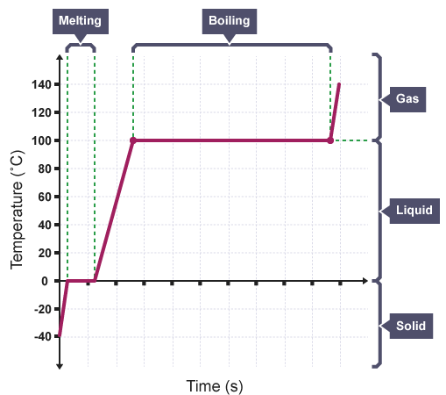
When you plot a graph showing the temperature of a substance, you can identify the melting and boiling points.
The graph will be horizontal when a change of state is taking place.
This happens because all the energy is being used to break the forces between the molecules and change state instead of increasing the temperature.

Slide 9
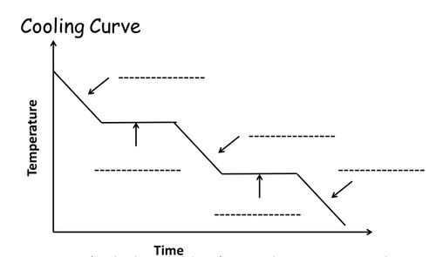
Copy and complete the graph using the following words:
Solid
Liquid
Gas
Condensing
Freezing

Slide 10

Create it
Create a method that would allow you to plot a cooling curve for stearic acid as it cools from a liquid to a solid.
Stearic acid is like candle wax. You would be able to melt it by putting a test tube of stearic acid into a beaker of boiling water.
If you are not sure, watch these video to help:
https://www.youtube.com/watch?v=vQKKJOW1fEg
https://www.youtube.com/watch?v=YUWJ2jGhE0M

