Slide 1
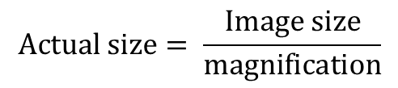
Mixtures and Separation
L/O – explain how to separate different mixtures
Last week: Define the terms:
Dominant allele
Recessive allele
Last term: Describe the advantages of an electron microscope
Last Year: An object was magnified 250 times to produce an image that was 40mm across. Calculate the actual size of the object.
Key Words
Mixtures
Chromatography
Crystallisation
Filtration
Distillation
$$Actual size= \frac{Image size}{magnification}$$

Slide 2
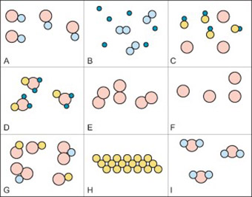
A pure substance has only one type of molecule in it.
Identify which of these diagrams show a pure substance

Slide 3
A pure substance has only one type of molecule in it.
The circled diagrams all show a pure substance because they only have one type of molecule.

Slide 4
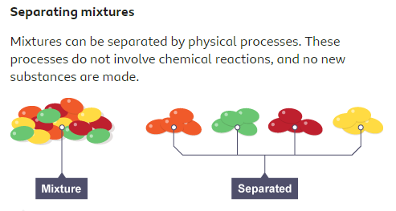
A pure substance consists only of one element or one compound
A mixture consists of two or more different substances, not chemically joined together

Slide 5
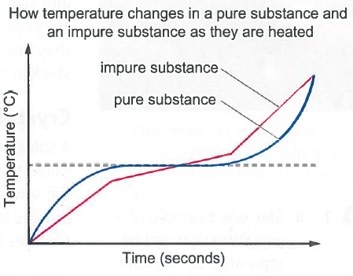
A pure substance has a fixed melting and boiling point.
An impure substance melts and boils at a range of different temperatures

Slide 6
Bronze: Describe the difference between a pure substance and an impure substance.
Silver: Justify why G is a mixture (impure substance) but I is a pure suibstance
Gold: Explain why a mixture of different substances might not have a single melting temperature.

Slide 7
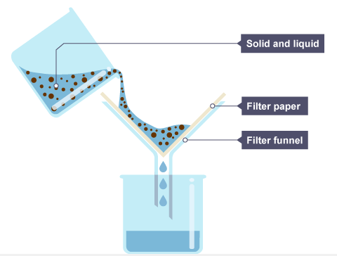
Filtration
Filtration allows you to separate an insoluble solid from a liquid
The liquid is able to pass through the filter paper but the solid cannot.

Slide 8
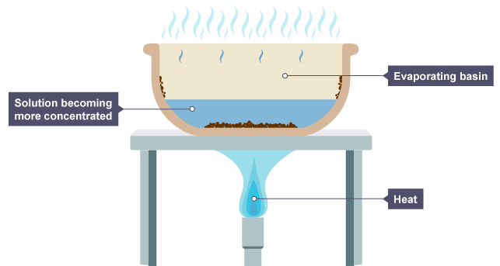
Crystallisation
If you have a soluble solid dissolved in a liquid, you cannot separate them by filtration.
You can evaporate the liquid, leaving behind the solid. This works because the solid has a much higher boiling point than the liquid

Slide 9
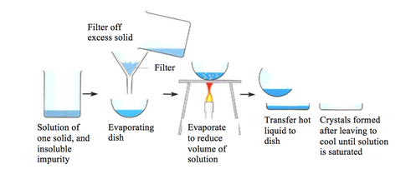
Filtration and crystallisation can be used together if you have both a soluble solid and insoluble solid.
For example a mixture of sand, salt and water.
https://www.youtube.com/watch?v=vi_SJBnxmHo

Slide 10
Bronze: Produce a clear, labelled diagram showing how filtration and crystallisation can be carried out.
Silver: Justify why filtration and separation can’t always be used for the same mixtures.
Gold: Evaluate the methods for both filtration and crystallisation. Identify any possible mistakes that could be made and hazards when carrying them out.

Slide 11
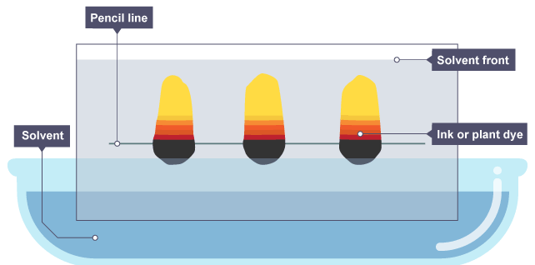
Chromatography
Paper chromatography is used to separate mixtures of soluble substances. These are often coloured substances such as food colourings, inks, dyes or plant pigments.

Slide 12
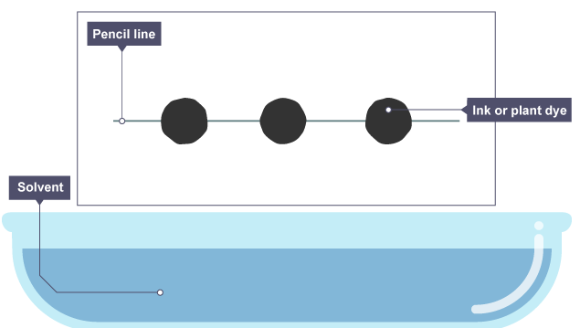
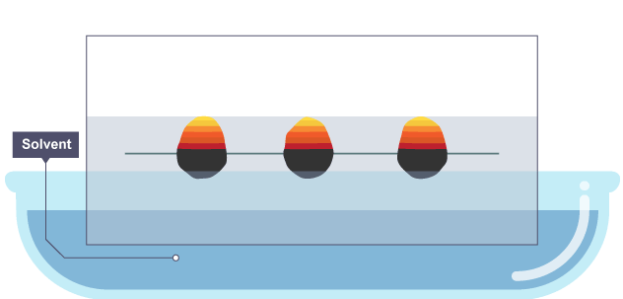
Chromatography
Some inks dissolve more easily than others. This means they will move up the paper faster.

Slide 13
Chromatography
In chromatography there are 2 phases:
Stationary phase – the paper (it doesn’t move)
Mobile phase – the solvent / liquid (it does move)

Slide 14
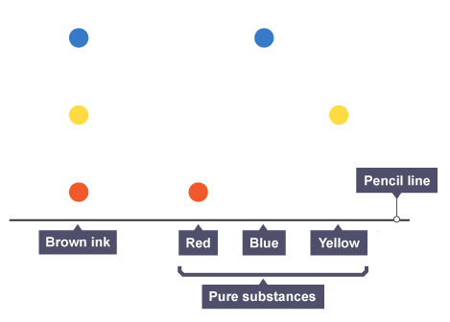
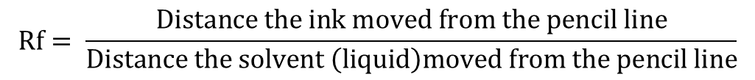
Chromatography
Separation by chromatography produces a chromatogram. A paper chromatogram can be used to distinguish between pure and impure substances:
a pure substance produces one spot on the chromatogram
an impure substance, or mixture, produces two or more spots
$$Rf= \frac{Distance the ink moved from the pencil line}{Distance the solvent \left(liquid\right)moved from the pencil line}$$

Slide 15
Chromatography
For each spot you can calculate the Rf value.
The Rf value tells you how easy it was for that substance to dissolve and move up the paper.

Slide 16
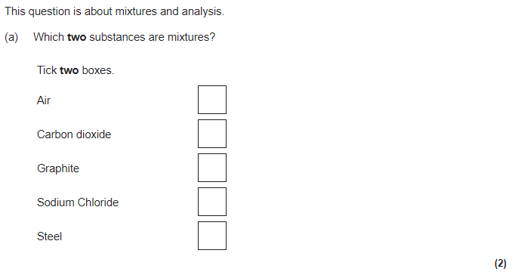
Exam Practice. Attempt each of the following exam questions

Slide 17
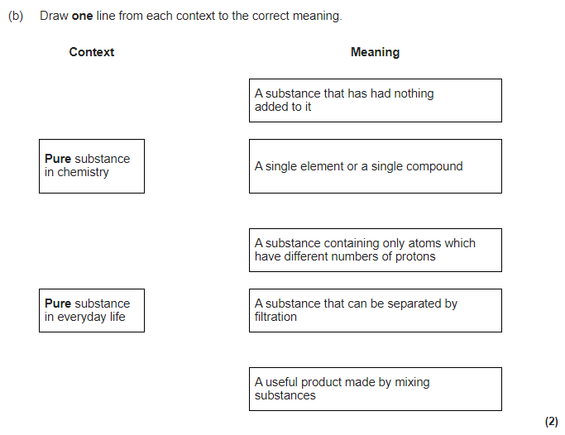

Slide 18
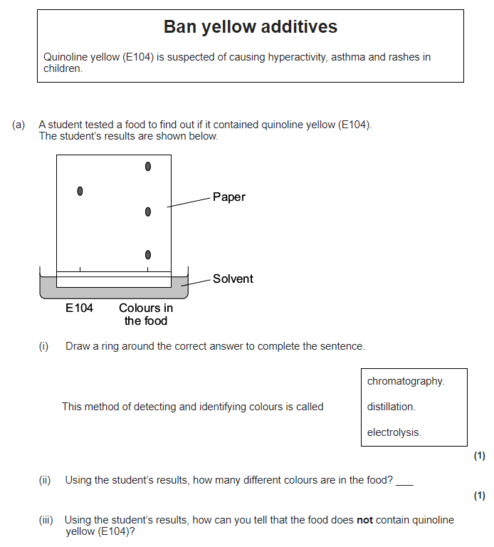

Slide 19
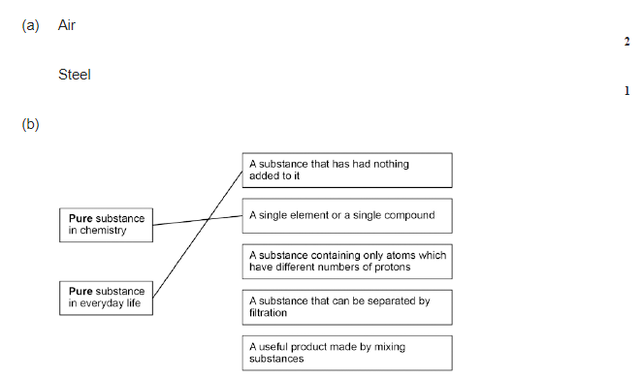
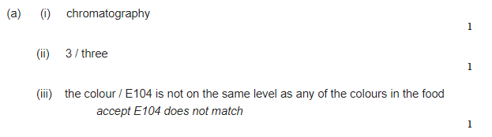
Self Assess your answers

