Slide 1
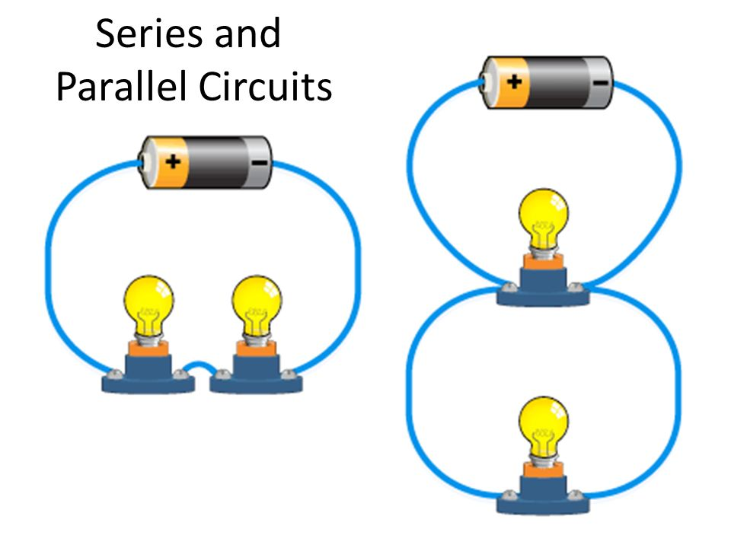
Potable Water
L/O – explain how to purify water
Last week: Describe where in an atom you would find the protons, neutrons and electrons
Last term: Explain why a bacteria cell is prokaryotic
Last Year: Identify which of these is a series circuit and which is a parallel circuit
Key Words
Distillation
Evaporation
Potable

Slide 2
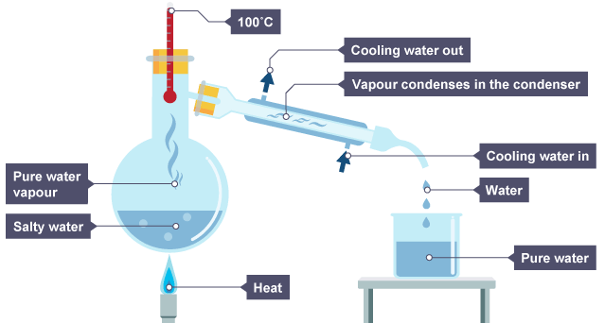
Distillation
Distillation is used to separate 2 different liquids.
Liquids have different boiling points. You can heat up the mixture so one of them evaporates but the other one does not.
You can then cool down the gas to condense it.

Slide 3
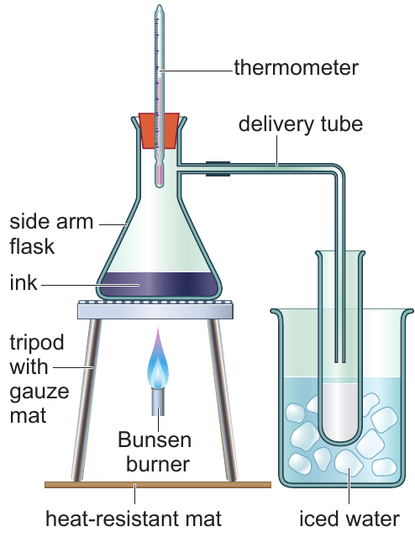
Simple Distillation Equipment

Slide 4
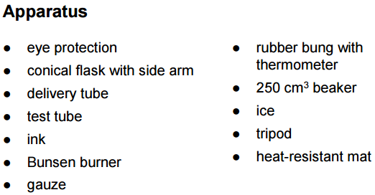
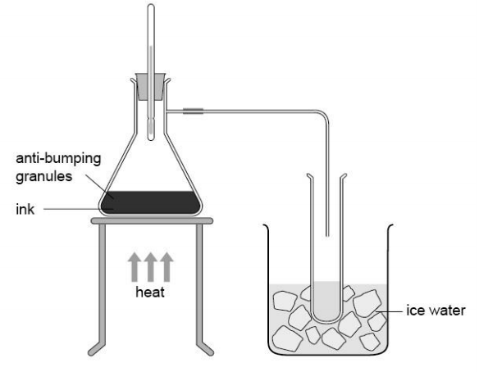
Set up your apparatus as shown in the diagram.
Adjust the Bunsen burner so that you have a gentle blue flame. The air hole should be about half open.
Heat the ink until it boils.
Collect the distillate in the test tube and note the temperature of the vapour.

Slide 5
Distillation was used to separate water from ink. Ink has a boiling point of around 200ºC
Bronze:
Identify the temperature at which the distillation took place [1 mark]
Describe how ensured no water vapour was lost [2 marks]
Silver:
A student carries out distillation on a sample of blue ink.
Predict how the appearance of the ink changes, and give a reason for your answer. [2 marks]
During the experiment a hot liquid drips from the bulb of the thermometer. Suggest an explanation for a temperature rise from 83ºC to 100ºC as this happens. [1 mark]
Gold:
Explain why simple distillation allows a pure solvent to be separated from a solution. [3 marks]
A student distils a sample of ink. Devise a simple method to show that the liquid collected is pure water. Include the expected results in your answer. [3 marks] (there is a clue in the bronze questions)

Slide 6
Potable water is water that is safe to drink.
To make it safe to drink, you need to remove any harmful substances or microbes from it.
https://www.youtube.com/watch?v=PDeiRlQvWnM
Distilled water is pure water, with no other substances in it.

Slide 7
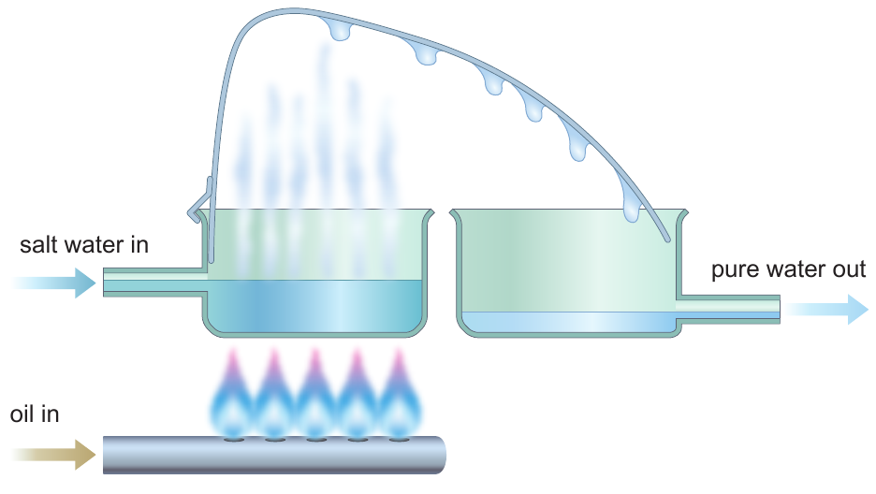
Purifying Sea Water
Purifying sea water requires a lot of energy.
It is carried out on a large scale when resources are plentiful, or when pure water is scarce.
Due to the high energy requirement it is avoided if possible.
Water that is safe to drink is called potable

Slide 8
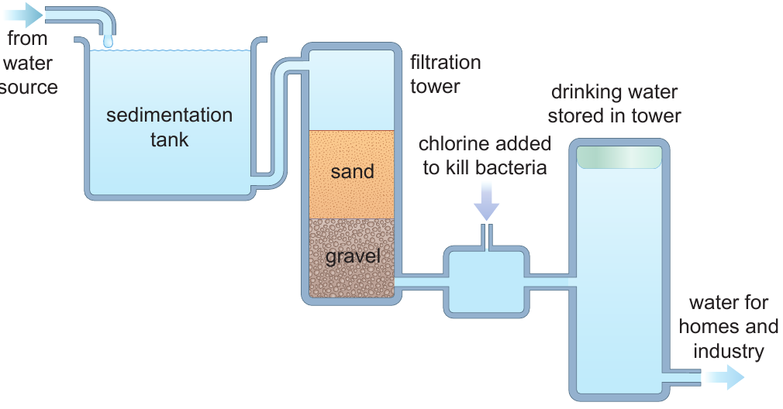
More often, drinking water comes from rivers or aquifers (underground water sources). It is often stored in reservoirs.
This water often contains leaves, twigs, soil, grit, salts, pesticides, fertilisers, bacteria and other microorganisms.

Slide 9
What problem could a reservoir of water have during the summer?
https://www.youtube.com/watch?v=2xtX8vaASek

Slide 10
Bronze:
Explain how pure water can be produced from salt water
Describe the stages of producing drinking water in the UK
Silver:
Explain why chemical analysis requires distilled water to be used
Produce a flow chart or diagram of the steps used to make drinking water in the UK.
Include the key words:
Chlorination
Filtration
Sedimentation
Gold:
Transform the stages of water purification into a flow diagram
Fresh water is treated to make it safe to drink. Soluble and insoluble substances are removed during this treatment, and chlorine is added to kill harmful bacteria. Explain two reasons why samples of the treated water are tested regularly.

Slide 11
Progress Questions
Look at the table below. Which substance is a gas at 90ºC?
Identify the name of the change of state being described below:
“During this process, particles gain enough energy to break free from their fixed positions. After this change, the particles stick together, but are free to move past each other.”
How many different phases are used in chromatography?
 | Ethanol | Water | Iodine
Melting point | -114 | 0 | 114
Boiling point | 78 | 100 | 184

