Slide 1
LQ: Can I Find equivalent ratios?
PLQ: Can I problem solve using equivalent ratios?
← 5 Minute Timer →
Do it Now – Simplify each ratio
KW: ratio, simplify, equivalent, bar model, fractions
Notes:
Students work in silence. Start the Timer for students to write down non-negotiables and to see who is late.
1. All Students copy down Title, LQ, PLQ, Date
2. All students write down Key Words
3. All students write attempt Do it Now

Slide 2
What are we learning today?
LQ: Can I Find equivalent ratios?
PLQ: Can I problem solve using equivalent ratios?
What? We are learning how to simplify ratios and find equivalent ratios | How? Use pictorial representations and bar models. Extend our understanding using worded problems. | Why? Ratios are used in cooking, dividing up money, proportions and in more advanced mathematics such as Trigonometry.
KW: ratio, simplify, equivalent, bar model, fractions
Notes:
Need to do

Slide 3
Find the ratio of orange counters to green counters in each parcel and simplify.
Which of these ratios are equivalent?
Find the fraction of orange counters in each parcel.
How does this relate to the ratio?
KW: ratio, simplify, equivalent, bar model, fractions
Notes:
Discuss who this shows simplifying ratios and equivalent ratios

Slide 4
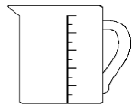
Orange squash
Orange squash is made by diluting bottles of orange with jugs of water.
This is how Ben makes his orange drink.
He mixes 2 bottles of orange with 4 jugs of
water.
Which of these drinks have the same strength as Ben’s?
KW: ratio, simplify, equivalent, bar model, fractions
Notes:
Discuss who this shows simplifying ratios and equivalent ratios

Slide 5
Orange squash 2
A new orange squash is made from squash and water in the ratio 1 : 4
Which of these mixtures have the same strength?.
2 : 6
10 : 40
2 : 8
5 : 25
3 : 12
1 : 5
5 : 20
Which mixture is the strongest?
KW: ratio, simplify, equivalent, bar model, fractions
Notes:
Explain how to simplify with different units.

Slide 6
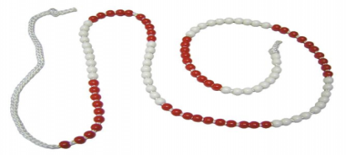
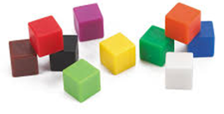
Equivalent ratios 1
10 :
: 100
: 55
1 : 5
9 :
: 1
6 :
KW: ratio, simplify, equivalent, bar model, fractions

Slide 7
Can you demonstrate what you have learned?
HINGE QUESTION
Which ratio is equivalent to 2: 3
← 30 Seconds →
3 : 2
4: 5
12 : 18
1 : 2
KW: ratio, simplify, equivalent, bar model, fractions
Notes:
Hinge Question:
Pupils Attempt question in Silence without the 4 multiple choice
Timer set on for students
Pupils look at the selection of answers and remember A, B, C or D

Slide 8
Can you demonstrate what you have learned?
HINGE QUESTION
Bronze
Bronze
Answer A.
Answer B.
Gold
Bronze
Answer C
Answer D
Reviewing Learning
KW: ratio, simplify, equivalent, bar model, fractions
Notes:
Students see their answers here which relate to the activity they will do on the next slide.
PowerPoint Tip – Move the Bronze, Silver, Gold bas around to the answers. The animations are already put in.

Slide 9
Bronze
Equivalent ratios
10 :
: 60
: 1
2 : 3
1 :
: 27
30 :
KW: ratio, simplify, equivalent, bar model, fractions

Slide 10
Equivalent ratios
Silver
12 : 18
: 36
: 36
:
1 :
: 150
48 :
KW: ratio, simplify, equivalent, bar model, fractions

Slide 11
Equivalent ratios
Silver
12 : 18
: 36
: 36
:
1 :
: 150
48 :
KW: ratio, simplify, equivalent, bar model, fractions

