Slide 1
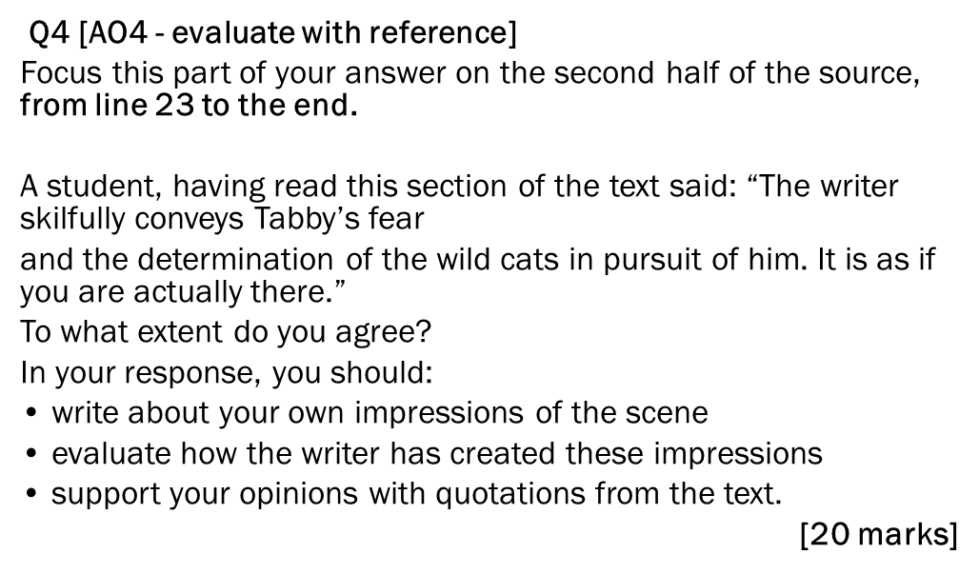

Slide 2
Q4 [AO4 - evaluate with reference]
Focus this part of your answer on the second half of the source, from line 26 to the end.
A student, having read this section of the text said: “The writer vividly conveys The horror of the situation. It is as if you are there with the narrator.”
To what extent do you agree?
In your response, you should:
• write about your own impressions of what the narrator sees
• evaluate how the writer has created these impressions
• support your opinions with quotations from the text. [20 marks]

Slide 3
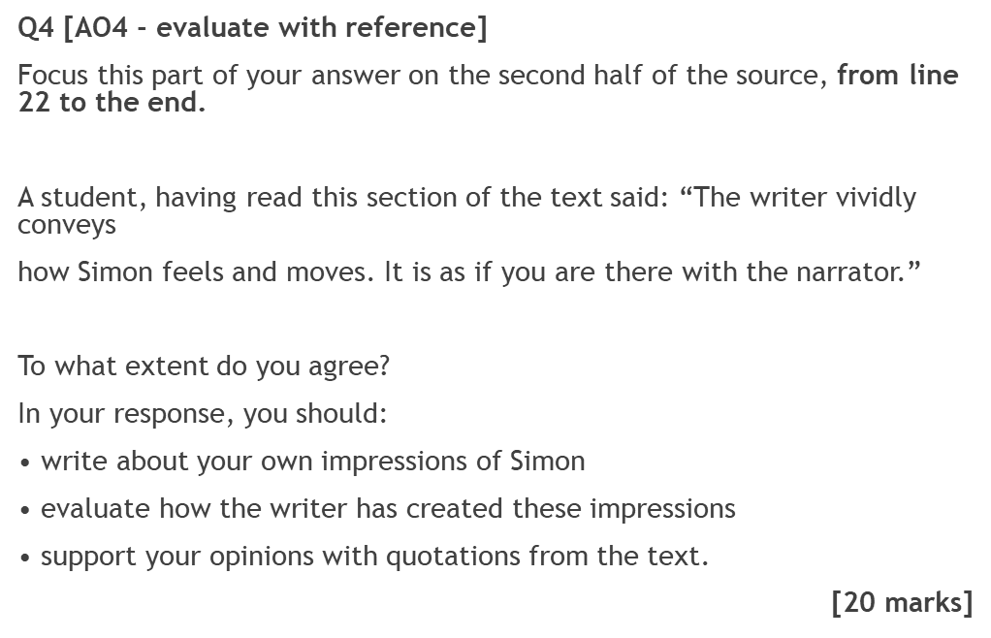

Slide 4
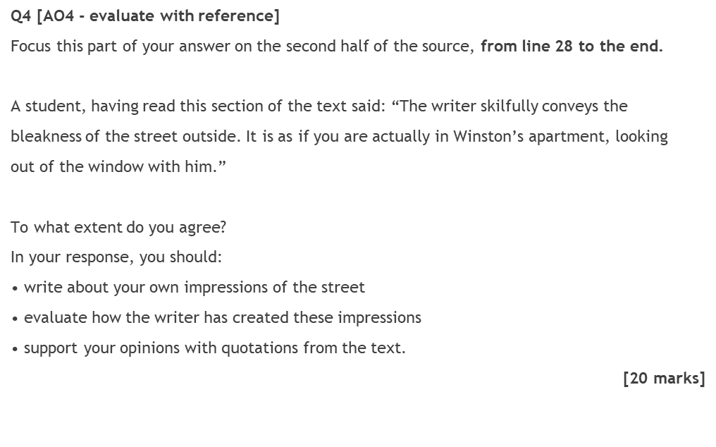

Slide 5
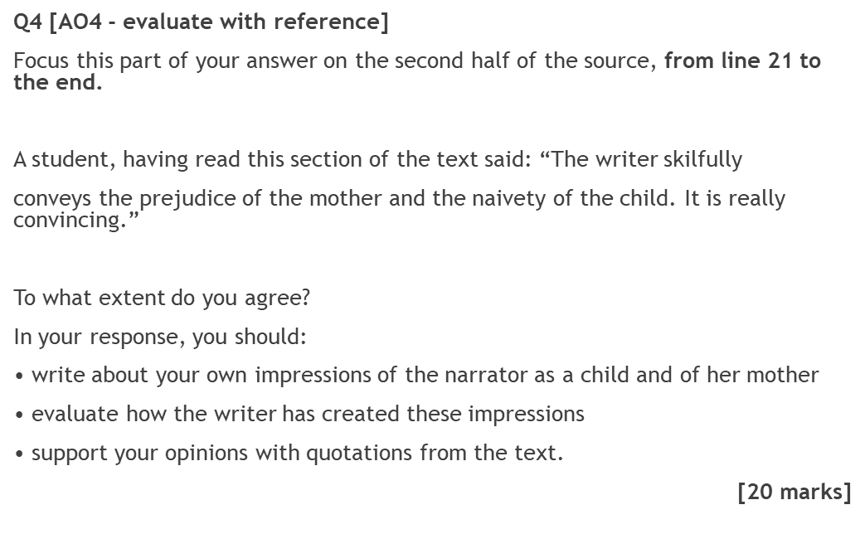

Slide 6
