Slide 1
Power of 3
LL: What was exchanged for slaves in Africa?
LW: What was the British Empire?
LY: Why did Henry VIII split from Rome?

Slide 2
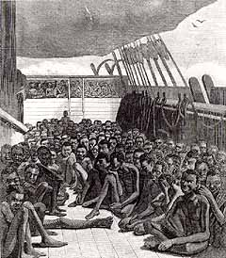
What can you infer from this picture about life on the Middle Passage?

Slide 3
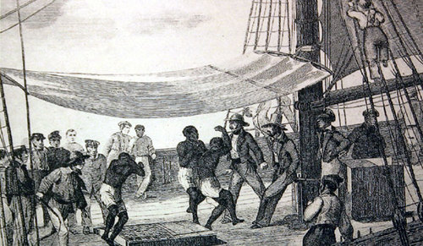
What can you infer from this picture about life on the Middle Passage?

Slide 4
What was life like for a slave on the Middle Passage?
BRONZE: State what it was like on board a slave ship
SILVER: Describe the key features of the middle passage
GOLD: Explain how slaves were treated during the middle passage
PLATINUM: To evaluate the worst part of the treatment of slaves during the middle passage and why slave ship owners did this
Key Words
The middle passage
Slave ships
The New World
Relevant Character Strengths:
Compassion, Curiosity, Resilience

Slide 5
What was life like for a slave on the Middle Passage?
Task - Read the sources on slide 5 and use the glossary on slide 6 if you need to:
BRONZE: State 5 facts you can find out about the middle passage
SILVER: Describe what each source tells you about life on board ship for a slave
GOLD: Explain the conditions and how slaves were treated on slave ships for each source
PLATINUM: Once you have completed Gold, what was the worst part of life on the middle passage?

Slide 6
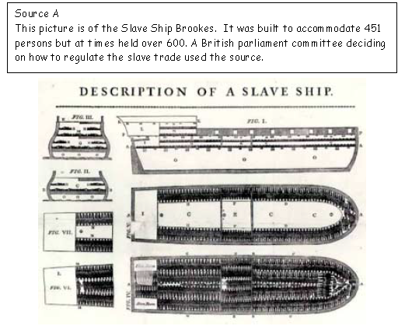
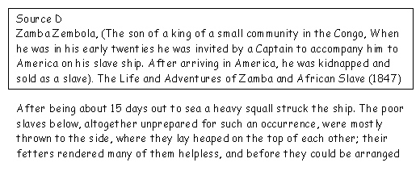
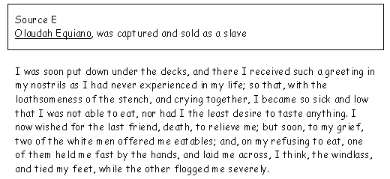
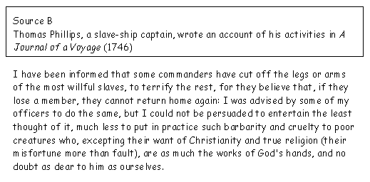
What was life like on the Middle Passage?
SOURCE C – VIDEO SOURCE:
https://www.youtube.com/watch?v=0IJrhQE6DZk

Slide 7
Glossary
Eatables - food
Fetters – handcuffs and chains
Flogged - whipped
Grievance – complaint at trouble caused
Member – legs, arms or another part of the body
Windlass – part of the ship

Slide 8
Plenary: Explaining the Middle Passage
Summarise conditions for slaves on Middle Passage
Slaves on the Middle Passage suffered horribly on board ship. For example,
Explain why you think that slaves were treated so severely?
Slaves were treated severely because they….

